Slide 1
Turning Risk into Resilience: Building Smarter Assessments
Jenna Feeney, CRA

Slide 2

About Me
Approximately 3 years of Corporate Compliance and RIM experience
  Insurance Operations experience 4+ years
Learning through experience, discussions with others, and recommended resources
Ask me about annuities if you
struggle to fall asleep at night
Cats, coffee, bicycling, books,
and family

Slide 3
Why Risk Assessments?
How RIM Risk Assessments Drive Business Value, Brand Equity, and Strategy

Slide 4
Evaluating Risks
Monday GPT:
“Risk assessments. Not exactly the kind of phrase that gets your heart racing—or at least, I hope not. But the truth is, whether we like it or not, they’re the quiet guardians of everything that doesn’t go catastrophically wrong. Today, I want to take a few minutes to talk about why these evaluations matter—not just as a bureaucratic checkbox, but as a critical tool for foresight, accountability, and making sure none of us ends up as a case study in a ‘what went wrong’ webinar.”
Notes:
Monday GPT: A personality experiment. You might not like it. It might not like you.

Slide 5
Enhance Business Outcomes
Informed decisions: Assessments highlight where resources and improvements are needed to avoid costly disruptions
  Data-driven insights lead to operational efficiencies and smarter prioritization
  Reference: ISO 31000
Stronger business continuity: Proactively identifying information risks protects operations and customer trust
  Minimizes the risk of inaccessible or lost records

Slide 6
Protect and Elevate Brand Equity
Demonstrates accountability and governance: Shows external stakeholders (e.g., regulators, partners) that the organization manages data and compliance proactively
  Builds trust and signals maturity
  References:
    SCCE Compliance Risk Assessment and Management Workshop, 2022
    Gartner, Take a Modern Approach to Data Governance, 2024
Reduces reputational risk: Fewer surprises, scandals, or fines tied to poor recordkeeping
  Maintains a clean public image and customer confidence

Slide 7
Aligns with Strategic Vision
Enables digital transformation: Managing legacy risks helps the organization modernize confidently
  Creates space for innovation
  Reference: AIIM State of the Intelligent Information Management Industry Report, 2022
Informs strategic risk appetite: Helps leaders define what levels and types of information risks are tolerable
  Aligns records governance with enterprise goals
Notes:
Risk assessments aren't just about preventing bad things—they're about enabling better things. They're a foundation for building trust, making bold decisions, and protecting what makes your organization valuable.

Slide 8
The Who, What, When, Where, Why, and How of Risk

Slide 9
Whose Risk is it Anyway?
Risk vs. IT vs. Internal Audit vs. Compliance vs. ___________
Other areas may conduct their own risk assessments or manage specific risks
But you can still have a resource of your own to help drive your area’s priorities and resources
Notes:
Who is responsible for identifying, owning, and evaluating risks?

Slide 10

What Exactly is Risk?
Risk: A situation involving exposure to danger or the possibility of loss, harm, or other adverse or unwelcome circumstance; a chance or situation involving such a possibility.
Source: Oxford English Dictionary
Image “meteor heading towards Earth” created by ChatGPT on 4/24/2025
Notes:
Hopefully none of your risks are this catastrophic

Slide 11



Where Risks Lurk
Laws and regulations

Slide 12

Where Risks Lurk
Laws and regulations
Company policies

Slide 13




Where Risks Lurk
Laws and regulations
Company policies
Culture, norms, tone, and expectations

Slide 14

Where Risks Lurk
Laws and regulations
Company policies
Culture, norms, tone, and expectations
Best practices

Slide 15

Where Risks Lurk
Laws and regulations
Company policies
Culture, norms, tone, and expectations
Best practices
Litigation threats

Slide 16


Where Risks Lurk
Laws and regulations
Company policies
Culture, norms, tone, and expectations
Best practices
Litigation threats
Business operations and activities

Slide 17

Where Risks Lurk
Laws and regulations
Company policies
Culture, norms, tone, and expectations
Best practices
Litigation threats
Business operations and activities
People
Uff da

Slide 18
Risk Assessment Time

Slide 19
Risk Assessments: More Than Just Paperwork
Systematic process – not a one and done process
Used to identify, evaluate, and prioritize potential threats
Which could negatively impact an organization’s operations, ability to do business, assets, reputation, or information
Another way to think about this:
Your neighbor next door starts a company to mimic yours but has no experience or knowledge in doing business like yours. What risks will they face?
Notes:
Remember Monday GPT’s comment: not a bureaucratic checkbox

Slide 20
What is a RIM Risk Assessment?
Through the lens of how records and information are created, managed, used, stored, and disposed of
Goal: Help organizations make informed decisions about:
  Where to focus resources – people, money, systems
  How to strengthen internal controls
  Support business continuity
  Promote responsible information governance

Slide 21
Types of Risks
Regulatory
  The risk of non-compliance with laws, regulations, or regulatory expectations that govern records and information management
Legal
  The risk of litigation, legal penalties, or loss of legal defensibility due to poor records practices
Operational
  The risk of process failures, inefficiencies, or disruptions caused by poor records handling, access issues, or inconsistent practices
Reputational/Best Practice
  The risk of reputational damage or falling short of professional standards and stakeholder expectations, even if not required by law
Notes:
Regulatory Risk
Example: Failing to retain records for the legally required period.
Legal Risk
Example: Inability to produce requested documents during discovery.
Operational Risk
Example: Employees not knowing where to find key information when needed.
Reputational / Best Practice Risk
Example: Publicized data mismanagement or failure to follow IG best practices.

Slide 22
Let’s Build a Risk Assessment
Risk Owner | Risk Category | Risk Description | Probability Score 1-5 | Impact Score 1-5 | Risk Score | Risk Mitigation Strategies | Mitigation Score 1-5 | Residual Risk Score | Residual Risk
Regulatory, Legal, Operational, or Best Practice
The likelihood the risk will happen
Probability x Impact Score
How much the mitigation strategies reduce the risk
The risk(s) that remain after mitigation
Which dept. “owns” the risk
A statement of the risk
How much impact the risk’s realization will have on your org
Risk Score minus Mitigation Score
Everything currently in place to prevent or eliminate the risk

Slide 23
Identifying Risk Owners
Risk Owner | Risk Category | Risk Description | Probability Score 1-5 | Impact Score 1-5 | Risk Score | Risk Mitigation Strategies | Mitigation Score 1-5 | Residual Risk Score | Residual Risk
This is the department who “owns” the described risk
Multiple areas or departments can own a risk
Recommended to fill this category in after the Risk Description and Mitigation Strategies have been completed
Notes:
Don’t list names – people come & go

Slide 24
Risk Category
Risk Owner | Risk Category | Risk Description | Probability Score 1-5 | Impact Score 1-5 | Risk Score | Risk Mitigation Strategies | Mitigation Score 1-5 | Residual Risk Score | Residual Risk
Identify 3-5 categories, such as:
  Regulatory
  Legal
  Operational
  Best Practice
Recommended to fill this in once the Risk Description has been completed

Slide 25
Risk Description
Risk Owner | Risk Category | Risk Description | Probability Score 1-5 | Impact Score 1-5 | Risk Score | Risk Mitigation Strategies | Mitigation Score 1-5 | Residual Risk Score | Residual Risk
A statement of a real or potential risk before any mitigation strategies are in place
State what the risk is without emotional interference or other factors
“Employees are not trained on or provided access to RIM policies and procedures.”
Only one risk per row

Slide 26
Risk Description
Risk Owner | Risk Category | Risk Description | Probability Score 1-5 | Impact Score 1-5 | Risk Score | Risk Mitigation Strategies | Mitigation Score 1-5 | Residual Risk Score | Residual Risk
Regulatory
  What regulatory activity has occurred within your industry which may have an impact on your organization’s RIM program?
  What unique geographical, societal, or political risks exist for your RIM program?
Legal
  What is the Litigation Hold process?
  What are employees actually doing when handling records?
  What are employees NOT doing when handling records?

Slide 27
Risk Description
Risk Owner | Risk Category | Risk Description | Probability Score 1-5 | Impact Score 1-5 | Risk Score | Risk Mitigation Strategies | Mitigation Score 1-5 | Residual Risk Score | Residual Risk
Operational
  Every sentence in a policy has been included for a reason – what risk does it address?
  Ask leadership and your IG/RIM committees: What keeps you up at night regarding RIM?
Reputational/Best Practice
  What RIM-related activities or incidents could tarnish your organization’s reputation?
  Are all concepts from the ARMA GARP or IG Implementation Model accounted for?
  How does the company culture impact RIM?

Slide 28
Risk Description
Risk Owner | Risk Category | Risk Description | Probability Score 1-5 | Impact Score 1-5 | Risk Score | Risk Mitigation Strategies | Mitigation Score 1-5 | Residual Risk Score | Residual Risk
Risk Owner | Risk Category | Risk Description
RIM Compliance | Regulatory | The RIM program is not or cannot be monitored or audited by internal, external, or regulatory authorities
Legal | Legal | Information subject to a Litigation Hold is not preserved appropriately
IT | Operational | Information sharing processes and standards are not established or communicated with employees
RIM IT | Best Practice | A RIM software system does not exist or is inadequate to meet the organization’s needs for managing records and information

Slide 29
Probability Scoring
Risk Owner | Risk Category | Risk Description | Probability Score 1-5 | Impact Score 1-5 | Risk Score | Risk Mitigation Strategies | Mitigation Score 1-5 | Residual Risk Score | Residual Risk
Important: This is before any mitigation strategies have been enacted

Slide 30
Probability Scoring
Risk Owner | Risk Category | Risk Description | Probability Score 1-5 | Impact Score 1-5 | Risk Score | Risk Mitigation Strategies | Mitigation Score 1-5 | Residual Risk Score | Residual Risk
Important: This is before any mitigation strategies have been enacted
BUT THAT’S NOT FAIR!

Slide 31
Probability Scoring
Risk Owner | Risk Category | Risk Description | Probability Score 1-5 | Impact Score 1-5 | Risk Score | Risk Mitigation Strategies | Mitigation Score 1-5 | Residual Risk Score | Residual Risk
Important: This is before any mitigation strategies have been enacted
We are assessing and evaluating the risk by itself with no other factors or variables involved
This is not a criticism of you, your program, or organization – it is looking at one risk and determining how likely it would be to happen if no safeguards are in place

Slide 32
Probability Scoring
Risk Owner | Risk Category | Risk Description | Probability Score 1-5 | Impact Score 1-5 | Risk Score | Risk Mitigation Strategies | Mitigation Score 1-5 | Residual Risk Score | Residual Risk
Scale 1 – 5
1 | Unlikely | Less than 10% chance it could happen
2 | Seldom | Might happen 10% – 35% of the time
3 | Occasional | Likelihood of 35% – 65%
4 | Likely | Probably will happen 65% – 90% of the time
5 | Certain | 100% certain it will happen

Slide 33


Inside Your Brain vs. My Reaction
Images created by ChatGPT on 4/24/2025

Slide 34
Impact Scoring
Risk Owner | Risk Category | Risk Description | Probability Score 1-5 | Impact Score 1-5 | Risk Score | Risk Mitigation Strategies | Mitigation Score 1-5 | Residual Risk Score | Residual Risk
Reminder: This is before any mitigation strategies have been enacted
We are assessing and evaluating the risk by itself with no other factors or variables involved
This is not a criticism of you, your program, or organization – it is looking at one risk and determining how likely it would be to happen if no safeguards are in place

Slide 35
Impact Scoring
Risk Owner | Risk Category | Risk Description | Probability Score 1-5 | Impact Score 1-5 | Risk Score | Risk Mitigation Strategies | Mitigation Score 1-5 | Residual Risk Score | Residual Risk
Scale 1 – 5
Usually, the cost in terms of money, fines, penalties, or amount of resources which would be allocated to remedy the effects of the risk
1 | Minor impact
2 | Low impact
3 | Moderate impact
4 | High impact
5 | Major impact

Slide 36
Initial Risk Score
Risk Owner | Risk Category | Risk Description | Probability Score 1-5 | Impact Score 1-5 | Risk Score | Risk Mitigation Strategies | Mitigation Score 1-5 | Residual Risk Score | Residual Risk
Take your Probability Score and multiply it with the Impact Score
This is your Risk Score
It probably won’t look good

Slide 37
Initial Risk Score
Risk Owner | Risk Category | Risk Description | Probability Score 1-5 | Impact Score 1-5 | Risk Score | Risk Mitigation Strategies | Mitigation Score 1-5 | Residual Risk Score | Residual Risk
Risk Owner | Risk Category | Risk Description | Probability Score 1-5 | Impact Score 1-5 | Risk Score
RIM Compliance | Regulatory | The RIM program is not or cannot be monitored or audited by internal, external, or regulatory authorities | 3 | 5 | 15
Legal | Legal | Information subject to a Litigation Hold is not preserved appropriately | 4 | 5 | 20
IT | Operational | Information sharing processes and standards are not established or communicated with employees | 4 | 4 | 16
RIM IT | Best Practice | A RIM software system does not exist or is inadequate to meet the organization’s needs for managing records and information | 5 | 2 | 10

Slide 38

Initial Risk Score
Image created by ChatGPT on 4/24/2025

Slide 39
Risk Mitigation Strategies
Risk Owner | Risk Category | Risk Description | Probability Score 1-5 | Impact Score 1-5 | Risk Score | Risk Mitigation Strategies | Mitigation Score 1-5 | Residual Risk Score | Residual Risk
Now tell me everything you’re doing to prevent or eliminate your risks – go on!
Separate each mitigation strategy on separate lines within the cell (Alt+Enter)
List policies, procedures, processes, checks and balances, oversight, training, lines of defense, etc.

Slide 40
Risk Mitigation Strategies
Risk Owner | Risk Category | Risk Description | Probability Score 1-5 | Impact Score 1-5 | Risk Score | Risk Mitigation Strategies | Mitigation Score 1-5 | Residual Risk Score | Residual Risk
Risk Description | Probability Score 1-5 | Impact Score 1-5 | Risk Score | Risk Mitigation Strategies
The RIM program is not or cannot be monitored or audited by internal, external, or regulatory authorities | 3 | 5 | 15 | *Annual assessment by Compliance *Program policies and processes establish a review framework
Information subject to a Litigation Hold is not preserved appropriately | 4 | 5 | 20 | *LH Policy and process is well established *Tone from the top *IT backups are in place
Information sharing processes and standards are not established or communicated with employees | 4 | 4 | 16 | *Policies and required training are provided to employees *Quarterly reminders sent to employees via email & intranet site
A RIM software system does not exist or is inadequate to meet the organization’s needs for managing records and information | 5 | 2 | 10 | *In talks with IT to implement a software solution *Purview is currently in use

Slide 41
Mitigation Scoring
Risk Owner | Risk Category | Risk Description | Probability Score 1-5 | Impact Score 1-5 | Risk Score | Risk Mitigation Strategies | Mitigation Score 1-5 | Residual Risk Score | Residual Risk
Scale 1 – 5 how much the Mitigation Strategies reduce the Risk
1 | Minor impact
2 | Low impact
3 | Moderate impact
4 | High impact
5 | Major impact

Slide 42
Residual Risk Score
Risk Owner | Risk Category | Risk Description | Probability Score 1-5 | Impact Score 1-5 | Risk Score | Risk Mitigation Strategies | Mitigation Score 1-5 | Residual Risk Score | Residual Risk
Risk Score minus the Mitigation Score
This is your final score
  Note: Evaluate further if score is now 0
Remember: Residual risk is an informed, strategic decision
  Some risks are inherently going to be higher
  High residual risk score does NOT equal a failure to mitigate
Notes:
If the residual risk score winds up being 0, then you are saying the risk no longer exists. Consider if this is true: could the risk never happen? If so, remove it from the assessment. If, however, the risk could still happen, leave it on the assessment but adjust your scores so the residual risk score is a 1 or higher. It may now be a low risk, but it’s still a risk.

Slide 43
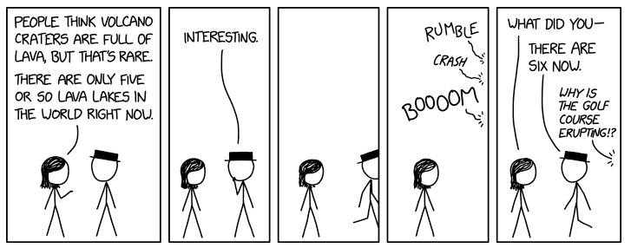
But My Risk is Fully Mitigated!
Risk Owner | Risk Category | Risk Description | Probability Score 1-5 | Impact Score 1-5 | Risk Score | Risk Mitigation Strategies | Mitigation Score 1-5 | Residual Risk Score | Residual Risk
Source: https://xkcd.com/2980

Slide 44
Identified Residual Risk
Risk Owner | Risk Category | Risk Description | Probability Score 1-5 | Impact Score 1-5 | Risk Score | Risk Mitigation Strategies | Mitigation Score 1-5 | Residual Risk Score | Residual Risk
Identify the remaining potential risks
Could include human error, machine error, a process owned by an area outside your sphere of influence, external factors, or lack of maturity in this area
Some of these risks could be a risk for the next open row
  Because risks rarely travel alone

Slide 45
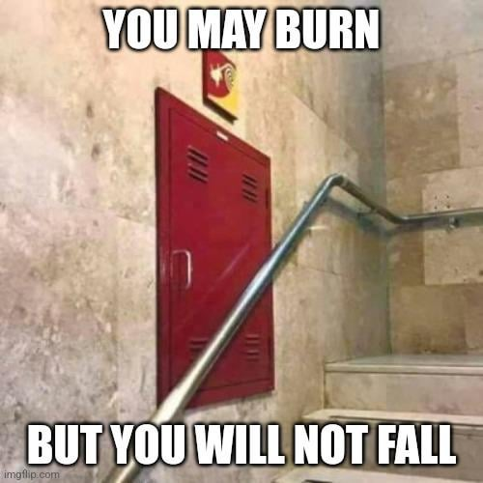
But Now I Have More Risks
Risk Owner | Risk Category | Risk Description | Probability Score 1-5 | Impact Score 1-5 | Risk Score | Risk Mitigation Strategies | Mitigation Score 1-5 | Residual Risk Score | Residual Risk
Notes:
Must find the sweet spot of not over-mitigating one risk to the detriment of another risk

Slide 46
Identified Residual Risk
Risk Owner | Risk Category | Risk Description | Probability Score 1-5 | Impact Score 1-5 | Risk Score | Risk Mitigation Strategies | Mitigation Score 1-5 | Residual Risk Score | Residual Risk
Risk Description | Probability Score 1-5 | Impact Score 1-5 | Risk Score | Risk Mitigation Strategies | Risk Mitigation Score | Residual Risk Score | Residual Risk
The RIM program is not or cannot be monitored or audited by internal, external, or regulatory authorities | 3 | 5 | 15 | *Annual assessment by Compliance *Program policies and processes establish a review framework | 4 | 11 | *External assessment or review has never taken place *The internal assessment process is not mature and still in development
Information subject to a Litigation Hold is not preserved appropriately | 4 | 5 | 20 | *LH Policy and process is well established *Tone from the top *IT backups are in place | 5 | 15 | *System failures or malfunctions may not backup as expected *Employees may delete information previously unknown to be relevant material

Slide 47
Identifying Risk Owners
Risk Owner | Risk Category | Risk Description | Probability Score 1-5 | Impact Score 1-5 | Risk Score | Risk Mitigation Strategies | Mitigation Score 1-5 | Residual Risk Score | Residual Risk
Risk Description | Probability Score 1-5 | Impact Score 1-5 | Risk Score | Risk Mitigation Strategies | Risk Mitigation Score | Residual Risk Score | Residual Risk
Information sharing processes and standards are not established or communicated with employees | 4 | 4 | 16 | *Policies and required training are provided to employees *Quarterly reminders sent to employees via email & intranet site | 4 | 12 | *Employees may share prohibited information or use processes which are not acceptable
A RIM software system does not exist or is inadequate to meet the organization’s needs for managing records and information | 5 | 2 | 10 | *In talks with IT to implement a software solution *Purview is currently in use | 2 | 8 | *Limited budget and resources *IT does not have capacity to implement a software solution

Slide 48
What’s Next?

Slide 49
You Have Risks… Now What?
Once all risks are assessed, prioritize your highest risks
  Shade cells red, yellow, and green to help visually represent the levels of risk
  Use these risks to guide your RIM program resources and projects
  Share with IG/RIM committees
  Can provide leverage to help you get what you need
Work with your leadership team to determine your risk tolerance
  How much risk is your area willing to accept?
  What kinds of risks is your organization willing to accept?
  How will accepted risks be reviewed, mitigated, and assessed?

Slide 50
Next Steps: Keeping the Momentum
Complete a full assessment review at least annually
  Add something new each year; for example:
    A new column detailing plans for the next year within each risk
    Incorporate a new resource of potential risks (regulation, aspect of RIM, privacy, etc.)
    Leverage AI to help identify gaps
Request an audit or assessment from Compliance/Risk/Internal Audit
  Identify one of your highest risks and ask them to assess the effectiveness of your mitigation strategies

Slide 51
Final Suggestions
Identify the things you can easily accomplish without additional budget or resources right now
Use AI:
  Upload your RIM/IG policies and procedures and ask AI to identify then classify each risk
  Ask AI to help identify possible risks
  AI can develop heat maps, charts, and other visuals to further your cause
Keep the discussion going with other leaders in your organization

Slide 52
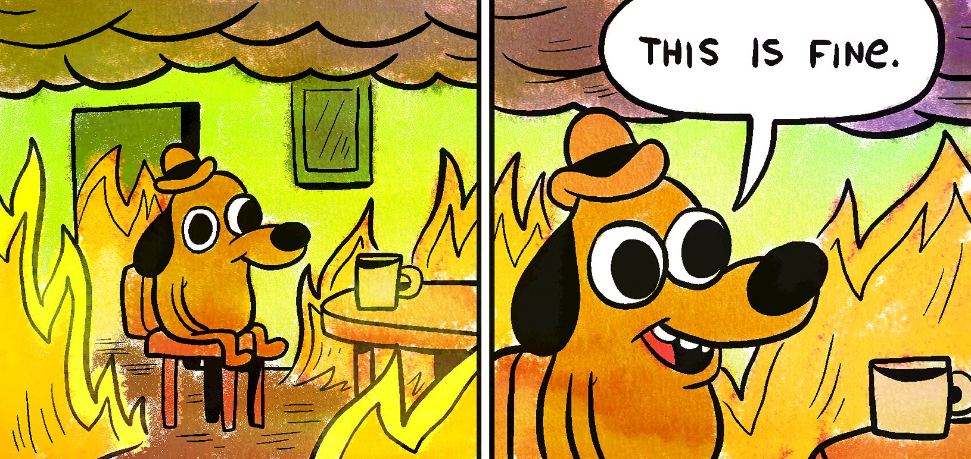
Final Thoughts

Slide 53
Questions
Jenna Feeney
jfeeney@athene.com
515-342-3225
LinkedIn
Additional References
  SCCE
  Gartner
  Ethisphere

