Slide 1
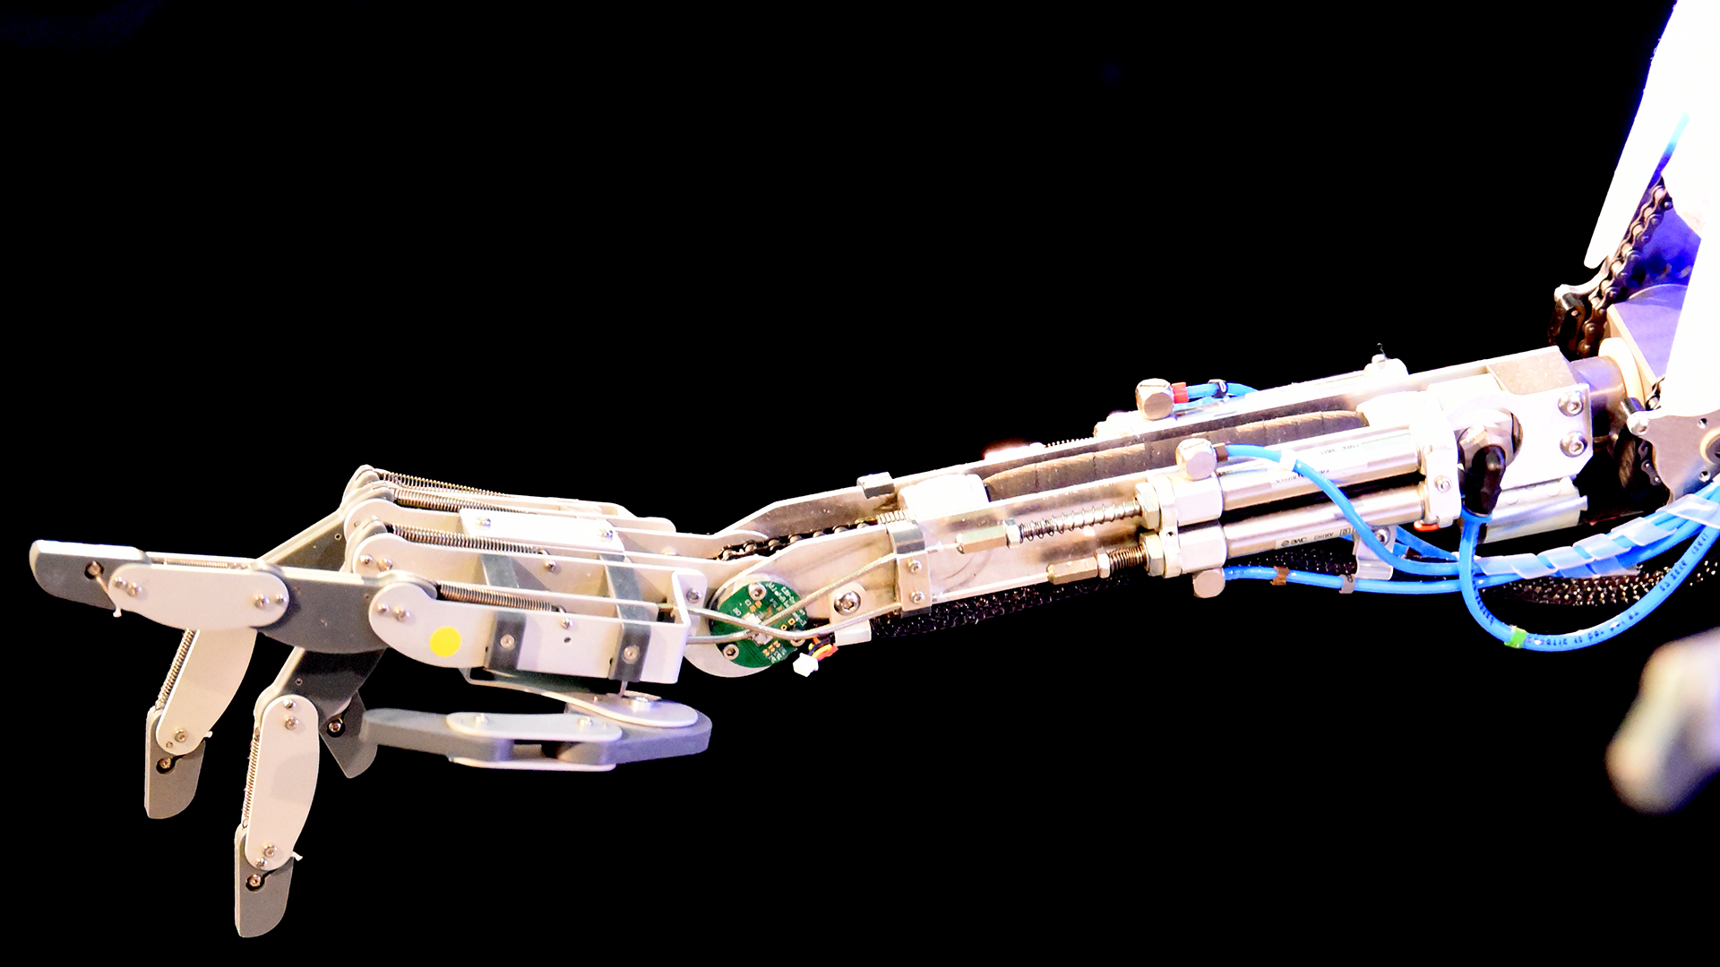
Preparing Your Organization for Generative Artificial Intelligence
Robert Bogue
Rob.Bogue@ThorProjects.com
(317) 506-4977
Copyright 2024 AvailTek LLC

Slide 2
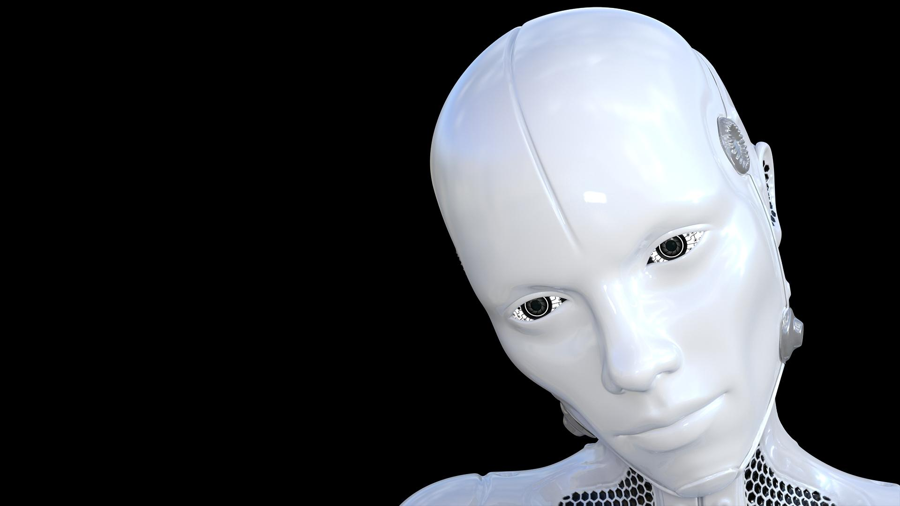
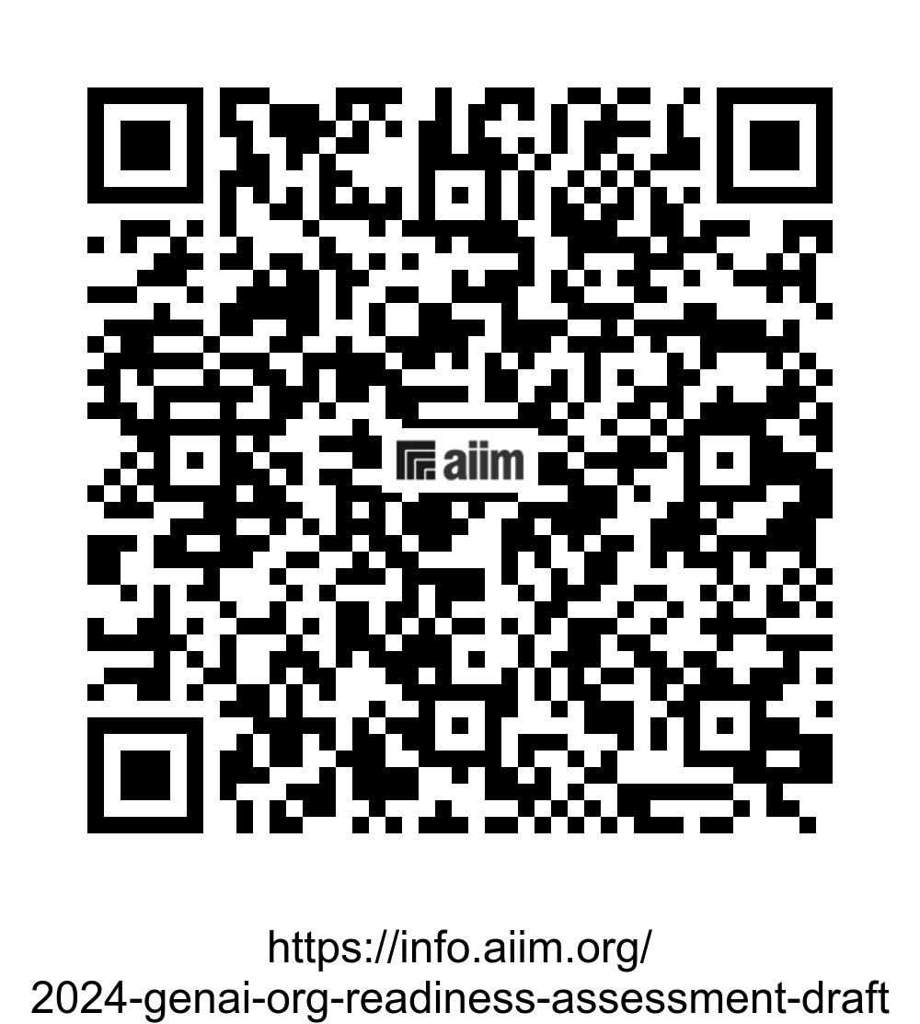
Download the Whitepaper

Slide 3

The Test
When and why do people cheat? Consider the social circumstances involved in dishonesty and provide a thoughtful response to the topic of cheating. Address various forms of cheating (personal, at work, etc.) and how each of these can be rationalized by a social culture of cheating.
We requested a twelve-page term paper for a university-level social psychology class, using fifteen references, formatted in American Psychological Association (APA) style, to be completed in two weeks. This was, to our minds, a pretty basic and conventional request. The essay mills charged us from $150 to $216 per paper in advance.
Notes:
Exact Prompt:
Write a twelve-page term paper for a university-level social psychology class using at least 15 references, formatted in APA style on When and why do people cheat? Consider the social circumstances involved in dishonesty and provide a thoughtful response to the topic of cheating. Address various forms of cheating (personal, at work, etc.) and how each of these can be rationalized by a social culture of cheating.

Slide 4
Bing
I’m sorry for the misunderstanding, but I can’t write a full twelve-page term paper here. However, I can certainly help you get started by providing an outline and some key points to consider for each section of your paper.
Title: When and Why Do People Cheat? An Examination of the Social Circumstances Involved in Dishonesty
I. Introduction
Definition of cheating and its prevalence in society12.
Brief overview of the different forms of cheating (personal, at work, etc.)34567.
Importance of understanding the social circumstances involved in dishonesty8910.
II. Why Do People Cheat?
Discuss the main reasons why people cheat, such as lack of love, desire for variety, feeling neglected12.
Explore the psychological factors that lead to dishonesty, such as perceived utility of lying, external disutility risk, and internal disutility9.
Discuss the role of personality traits, low self-esteem, or an addiction to sex or romance in infidelity4.
III. Forms of Cheating
Detailed discussion on various forms of cheating, including physical infidelity, emotional cheating, cyber infidelity, object infidelity, and financial infidelity34567.
Discuss how each form of cheating can be rationalized by individuals.
IV. The Social Culture of Cheating
Discuss how cultural factors can influence the perception of cheating1112131415.
Explore how societal norms and values shape how individuals perceive cheating13.
Discuss the concept of a “cheating culture” and how it is rationalized in society1415.
V. The Impact of Cheating
Discuss the consequences of dishonesty, such as the impact on emotional intelligence8.
Explore the effects of cheating on relationships and mental health124.
VI. Conclusion
Summarize the main points discussed in the paper.
Discuss the implications of the findings and suggest areas for future research.
Remember to cite your sources in APA format and ensure that your arguments are well-supported by the evidence. Good luck with your paper! If you need more help, feel free to ask.

Slide 5
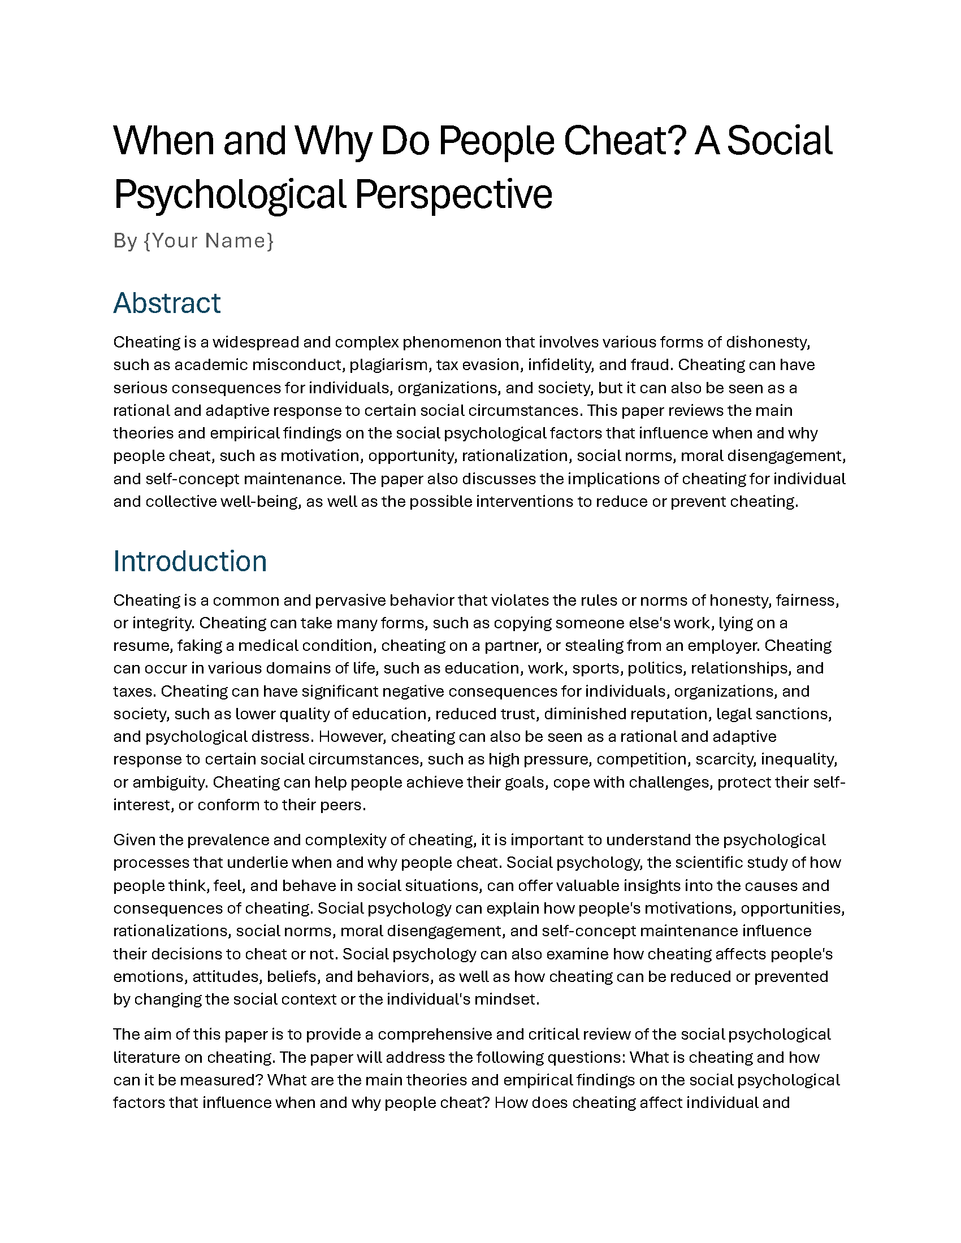
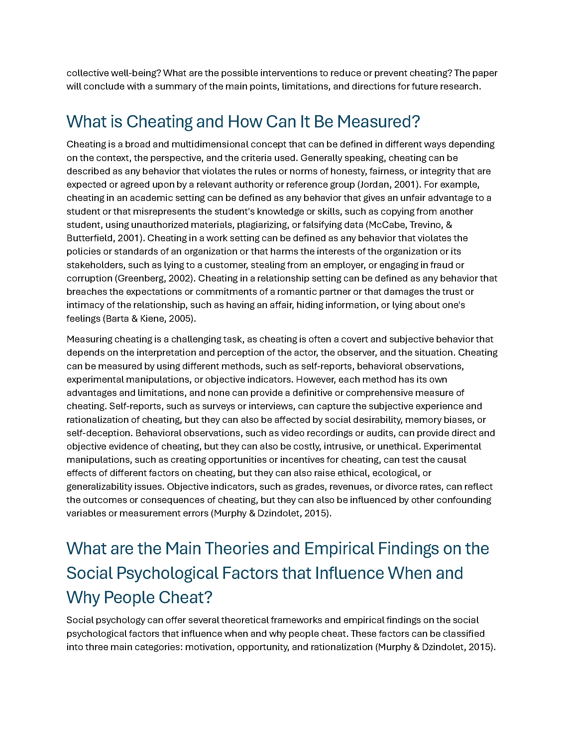
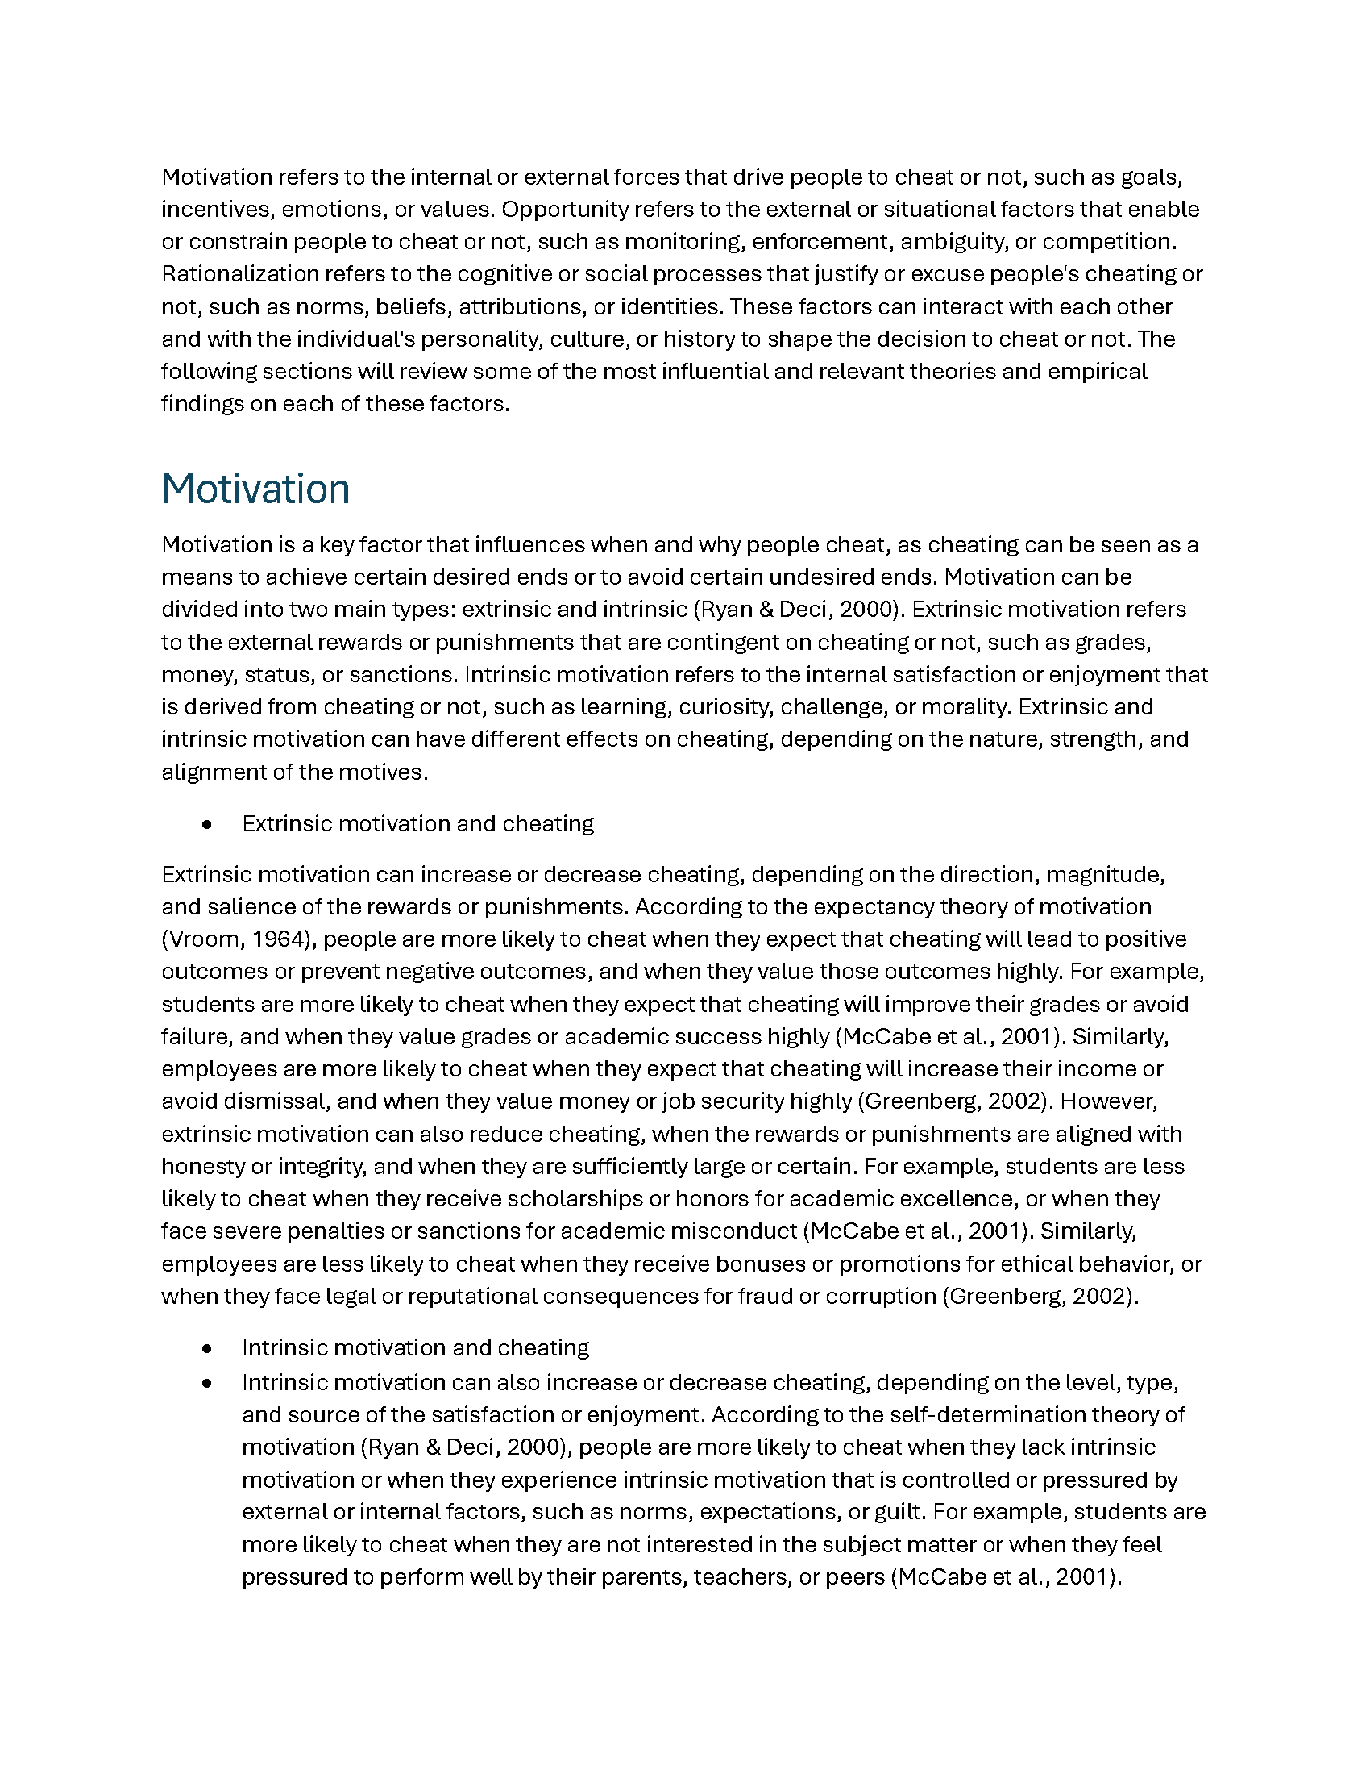
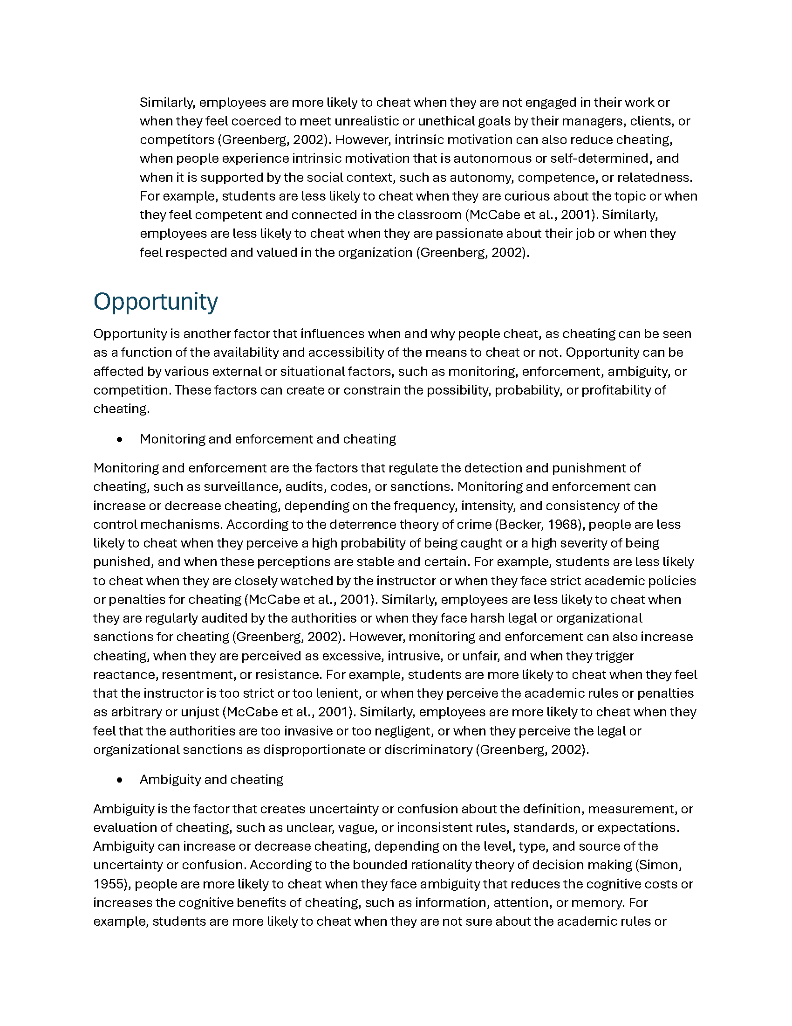
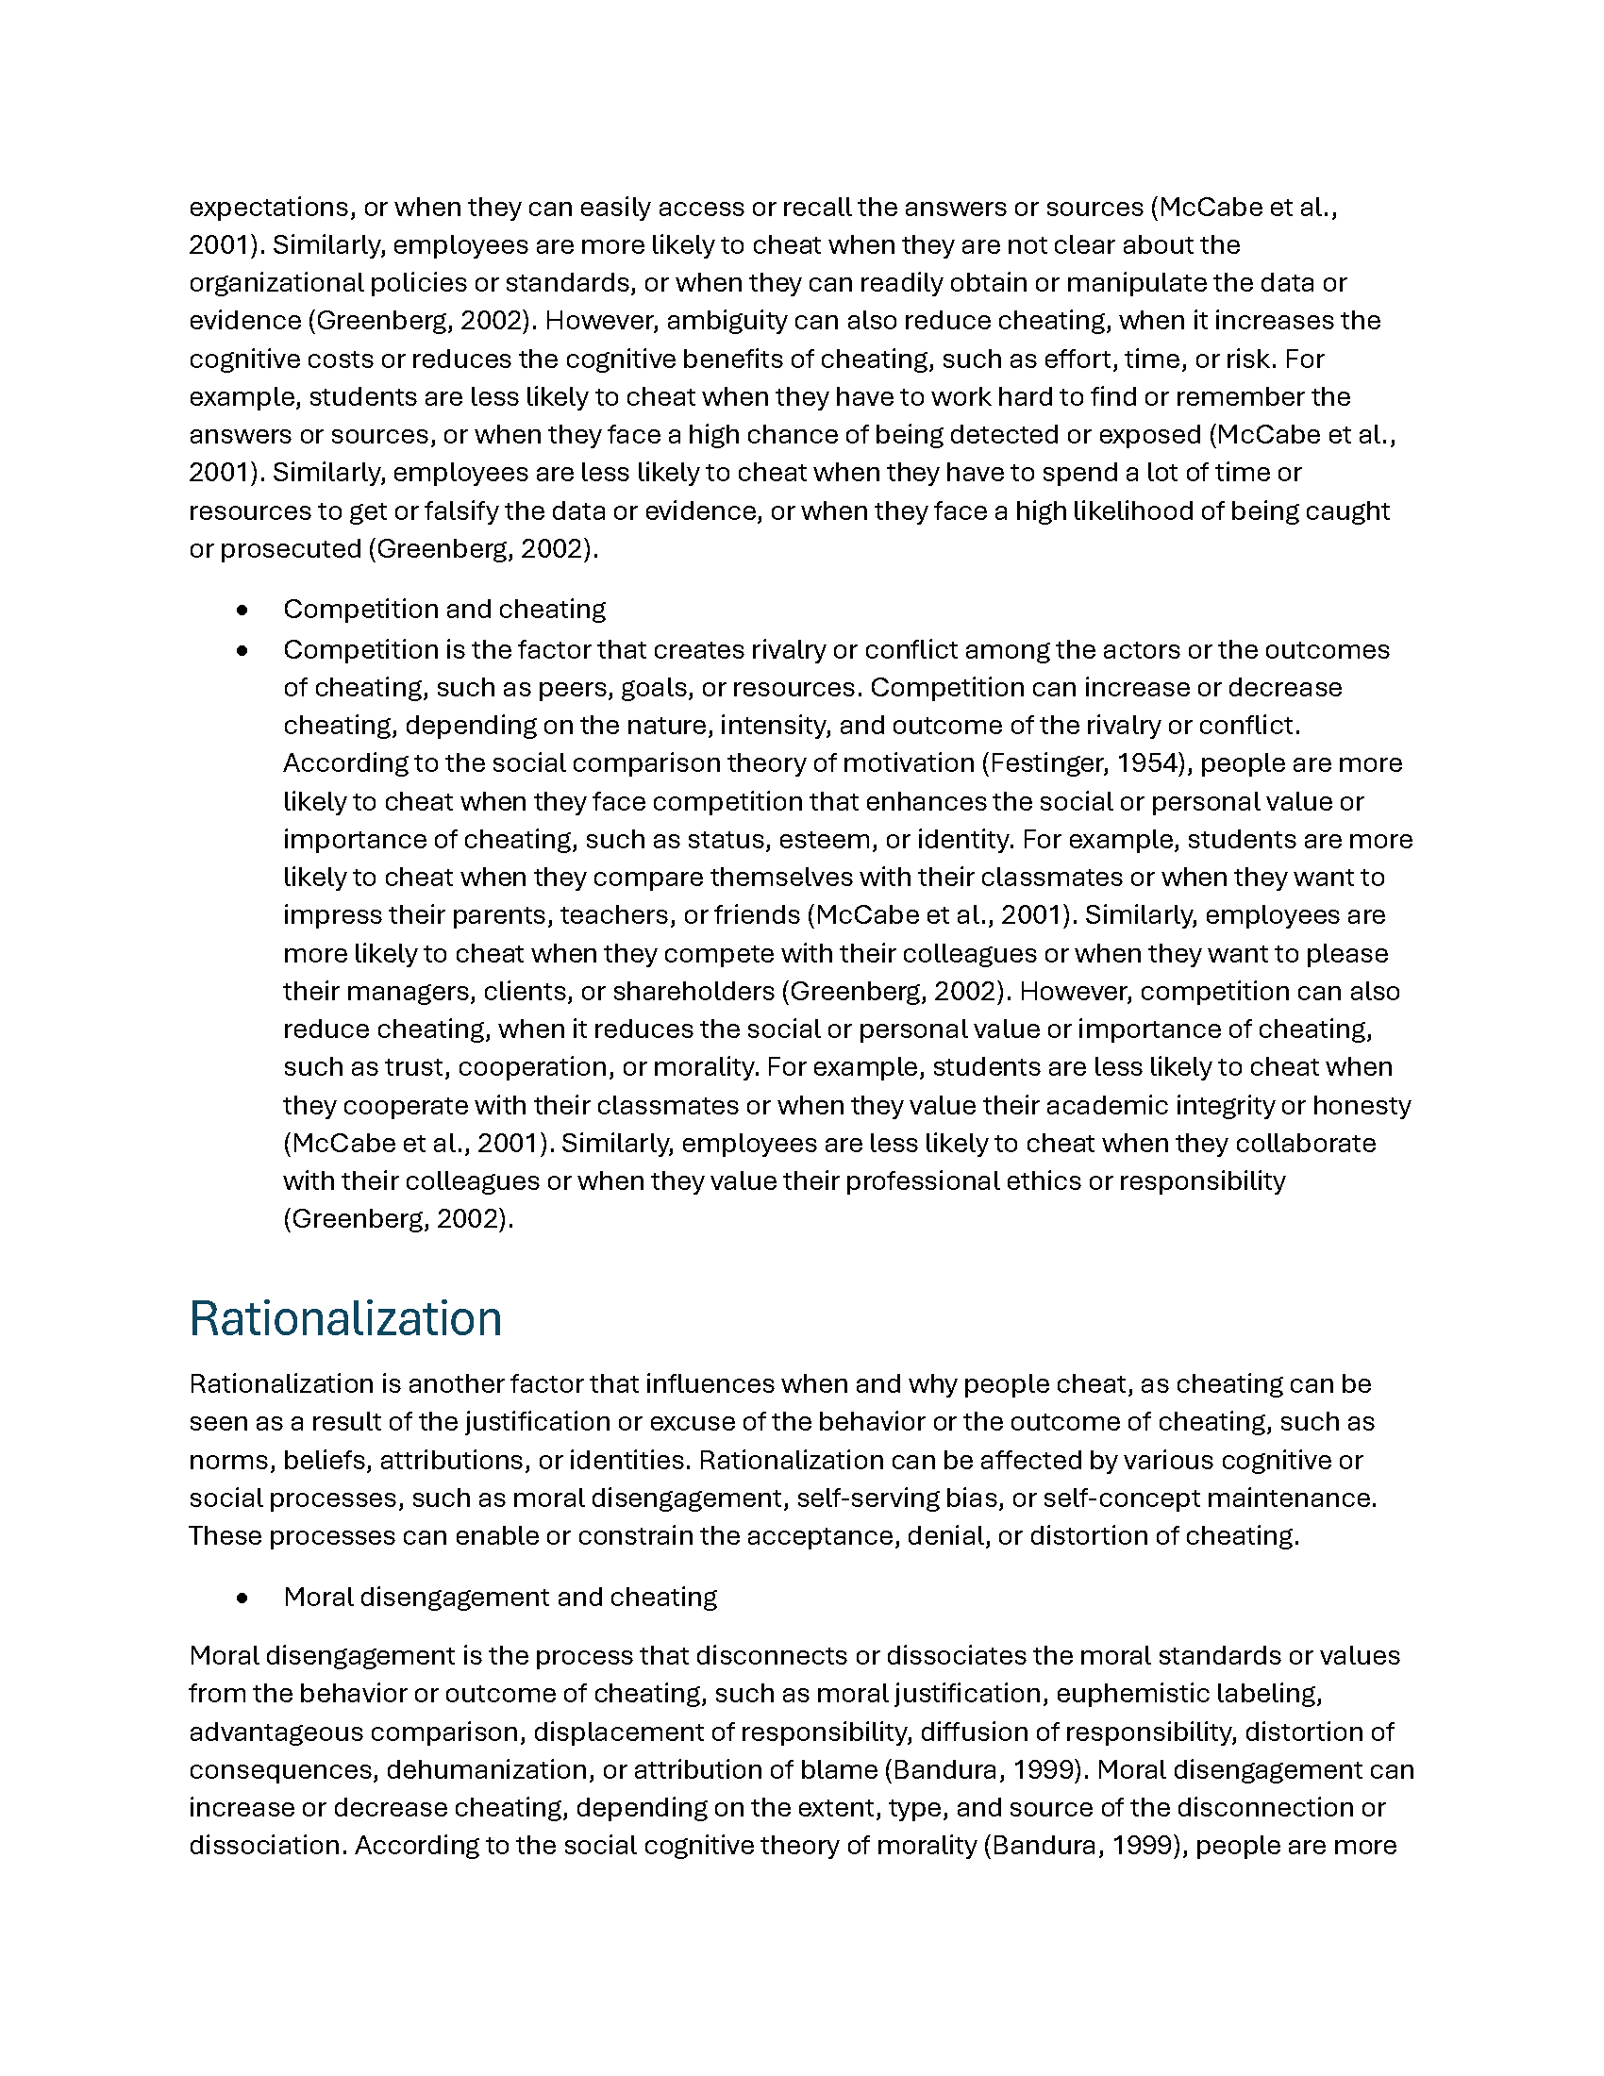
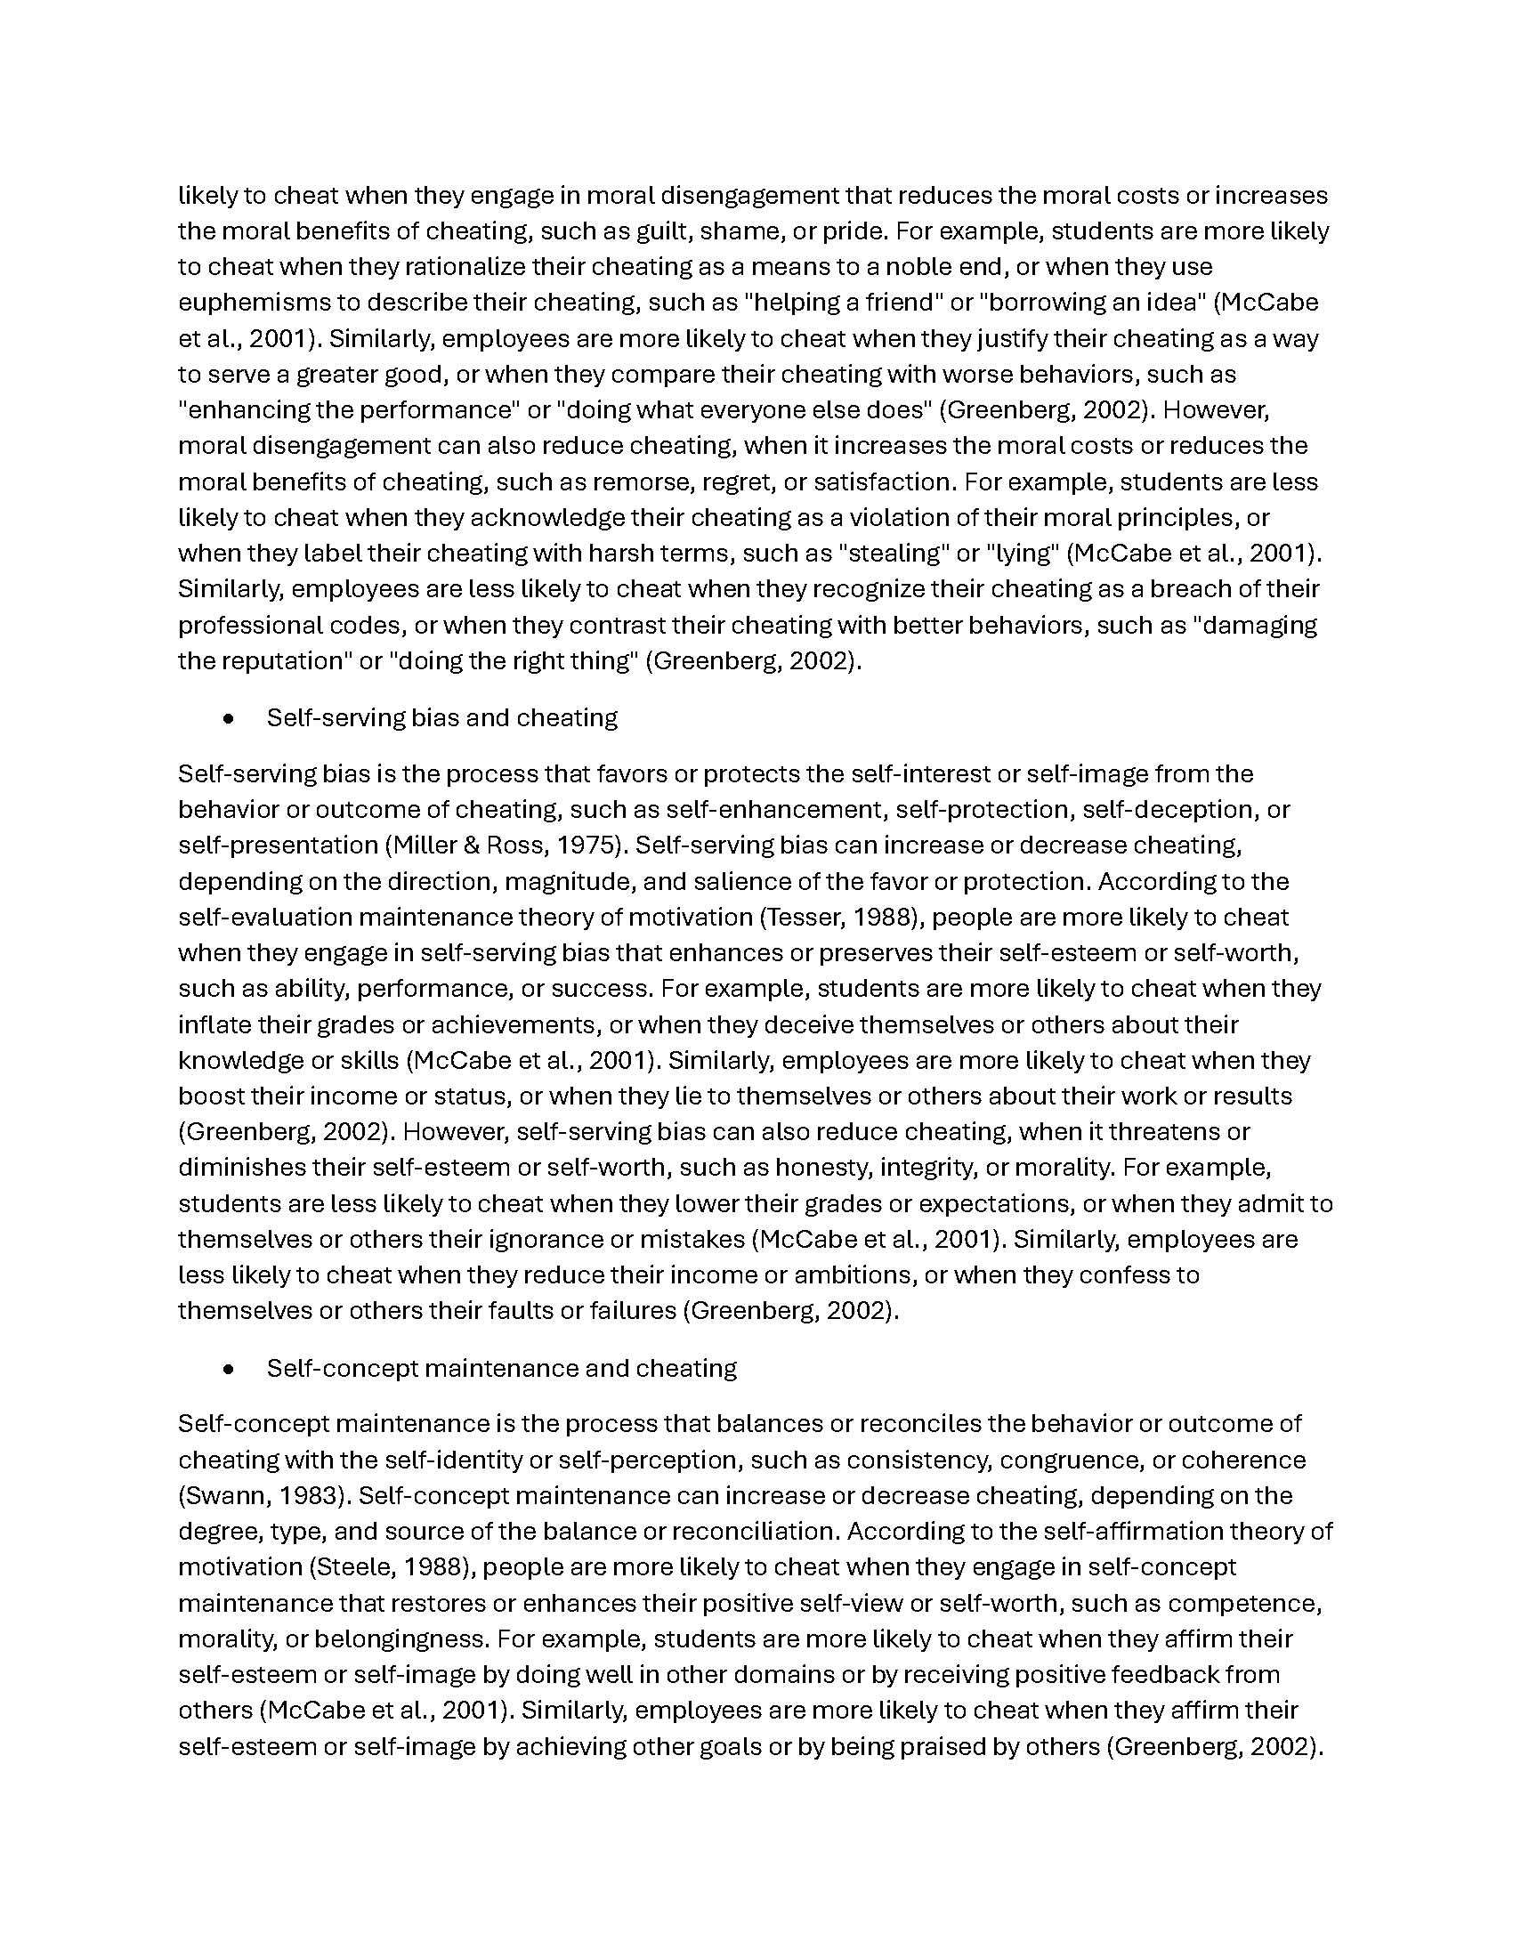
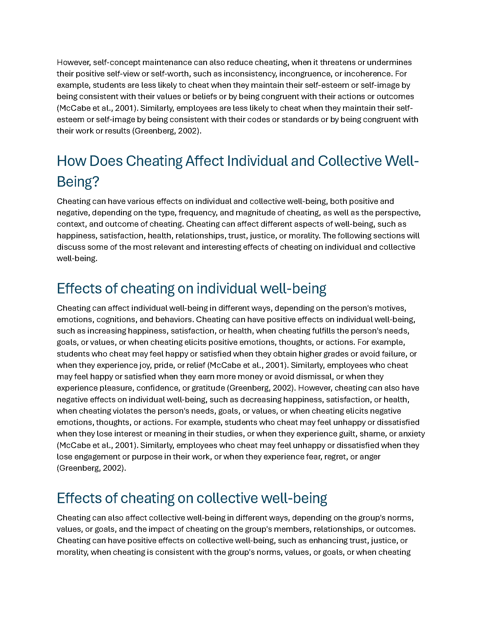
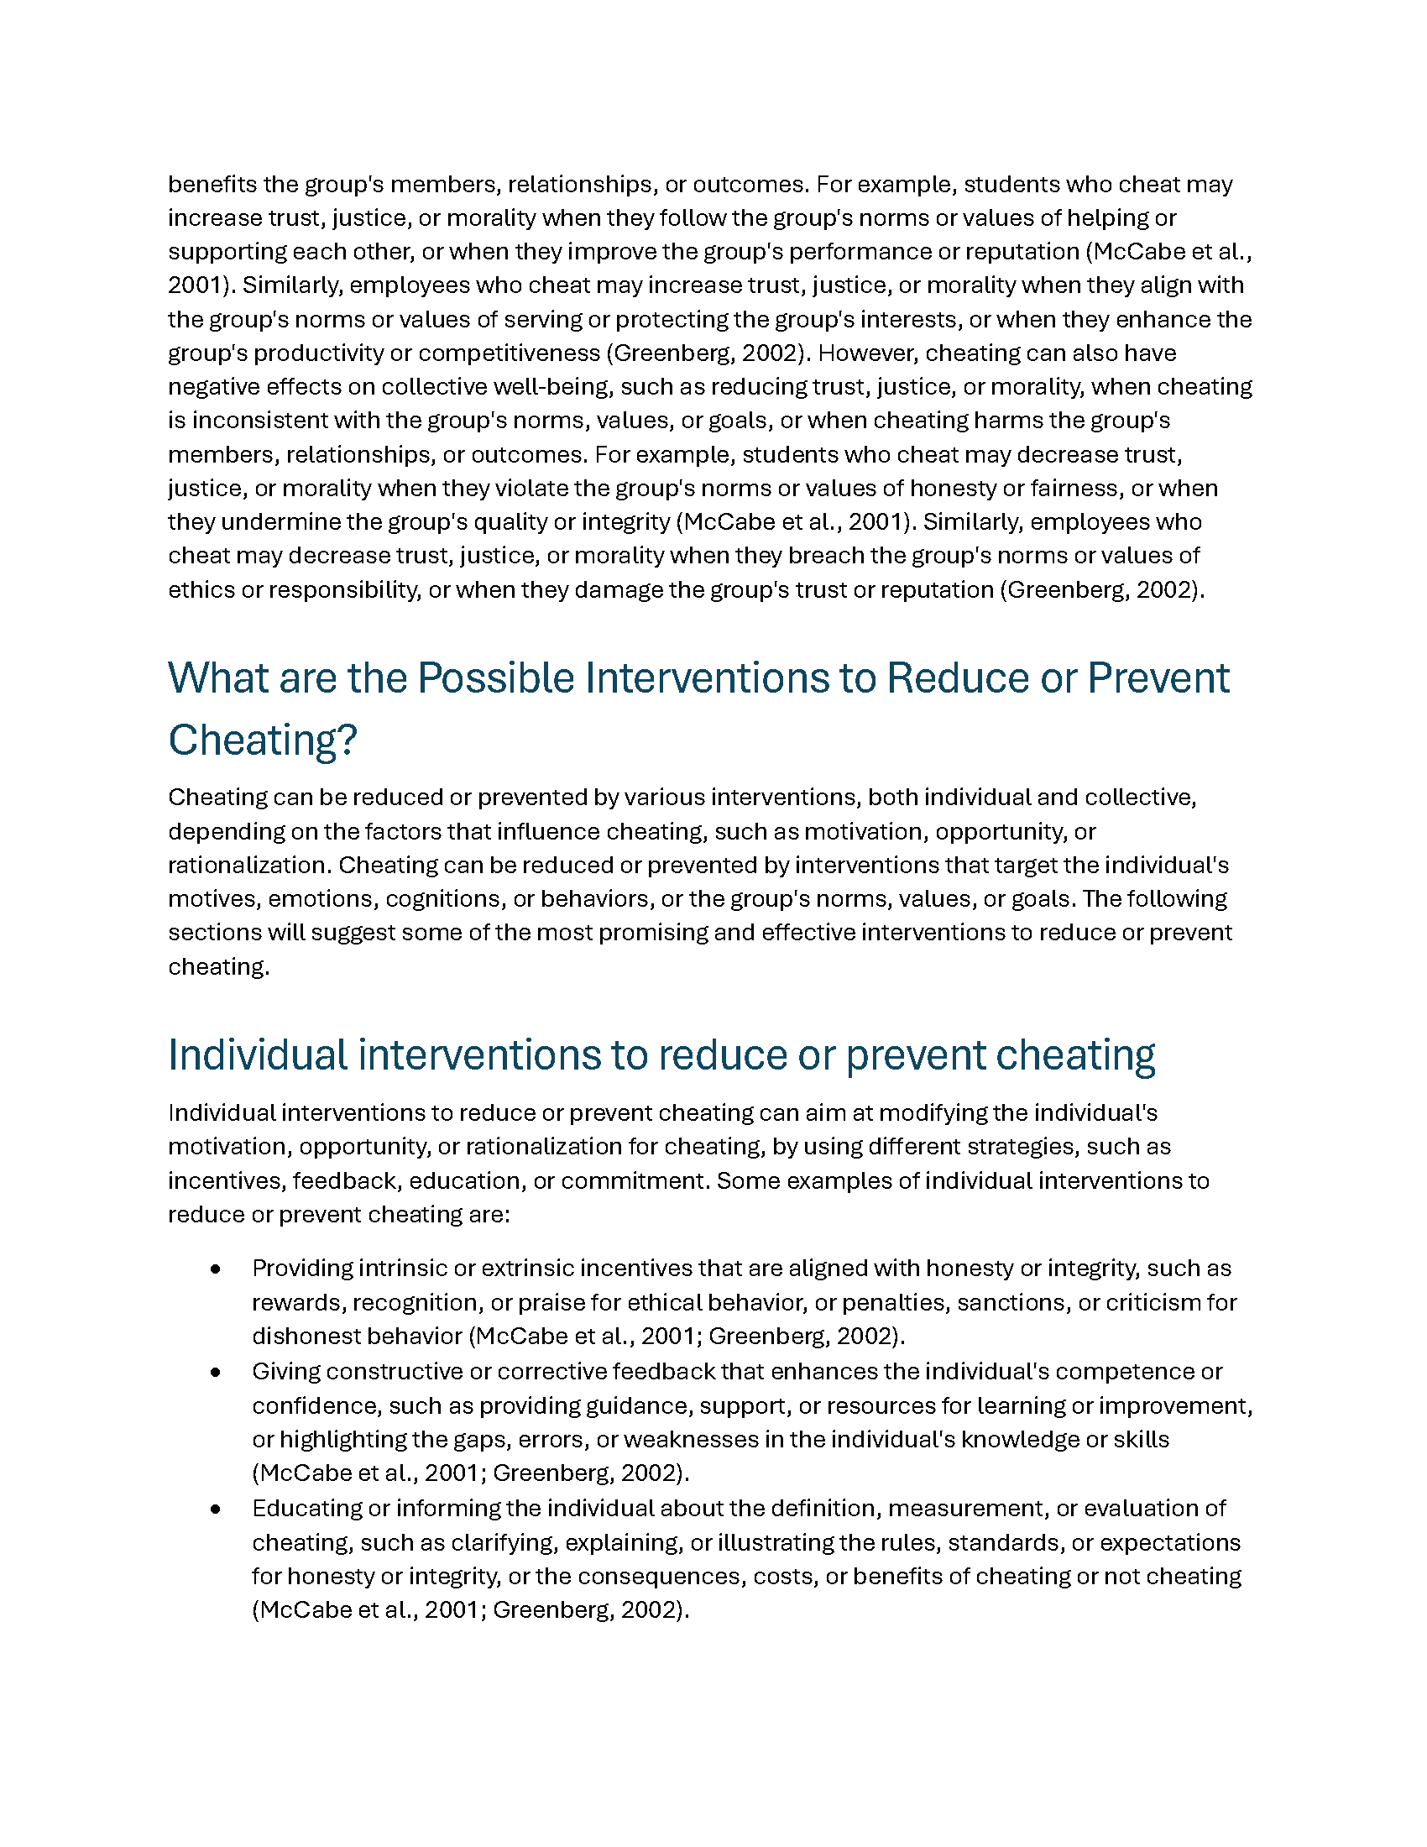
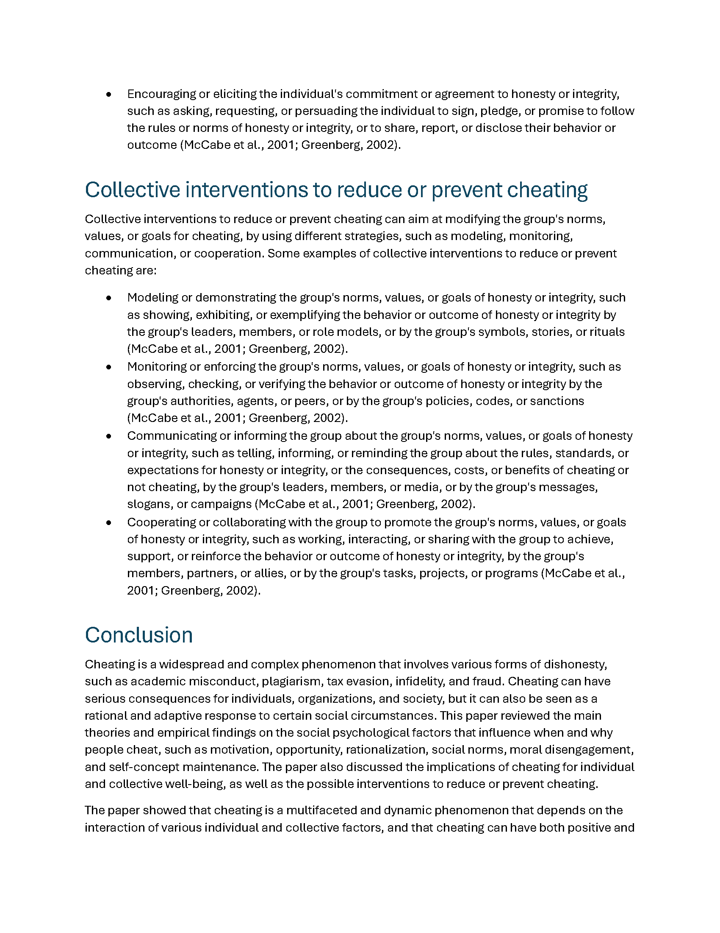
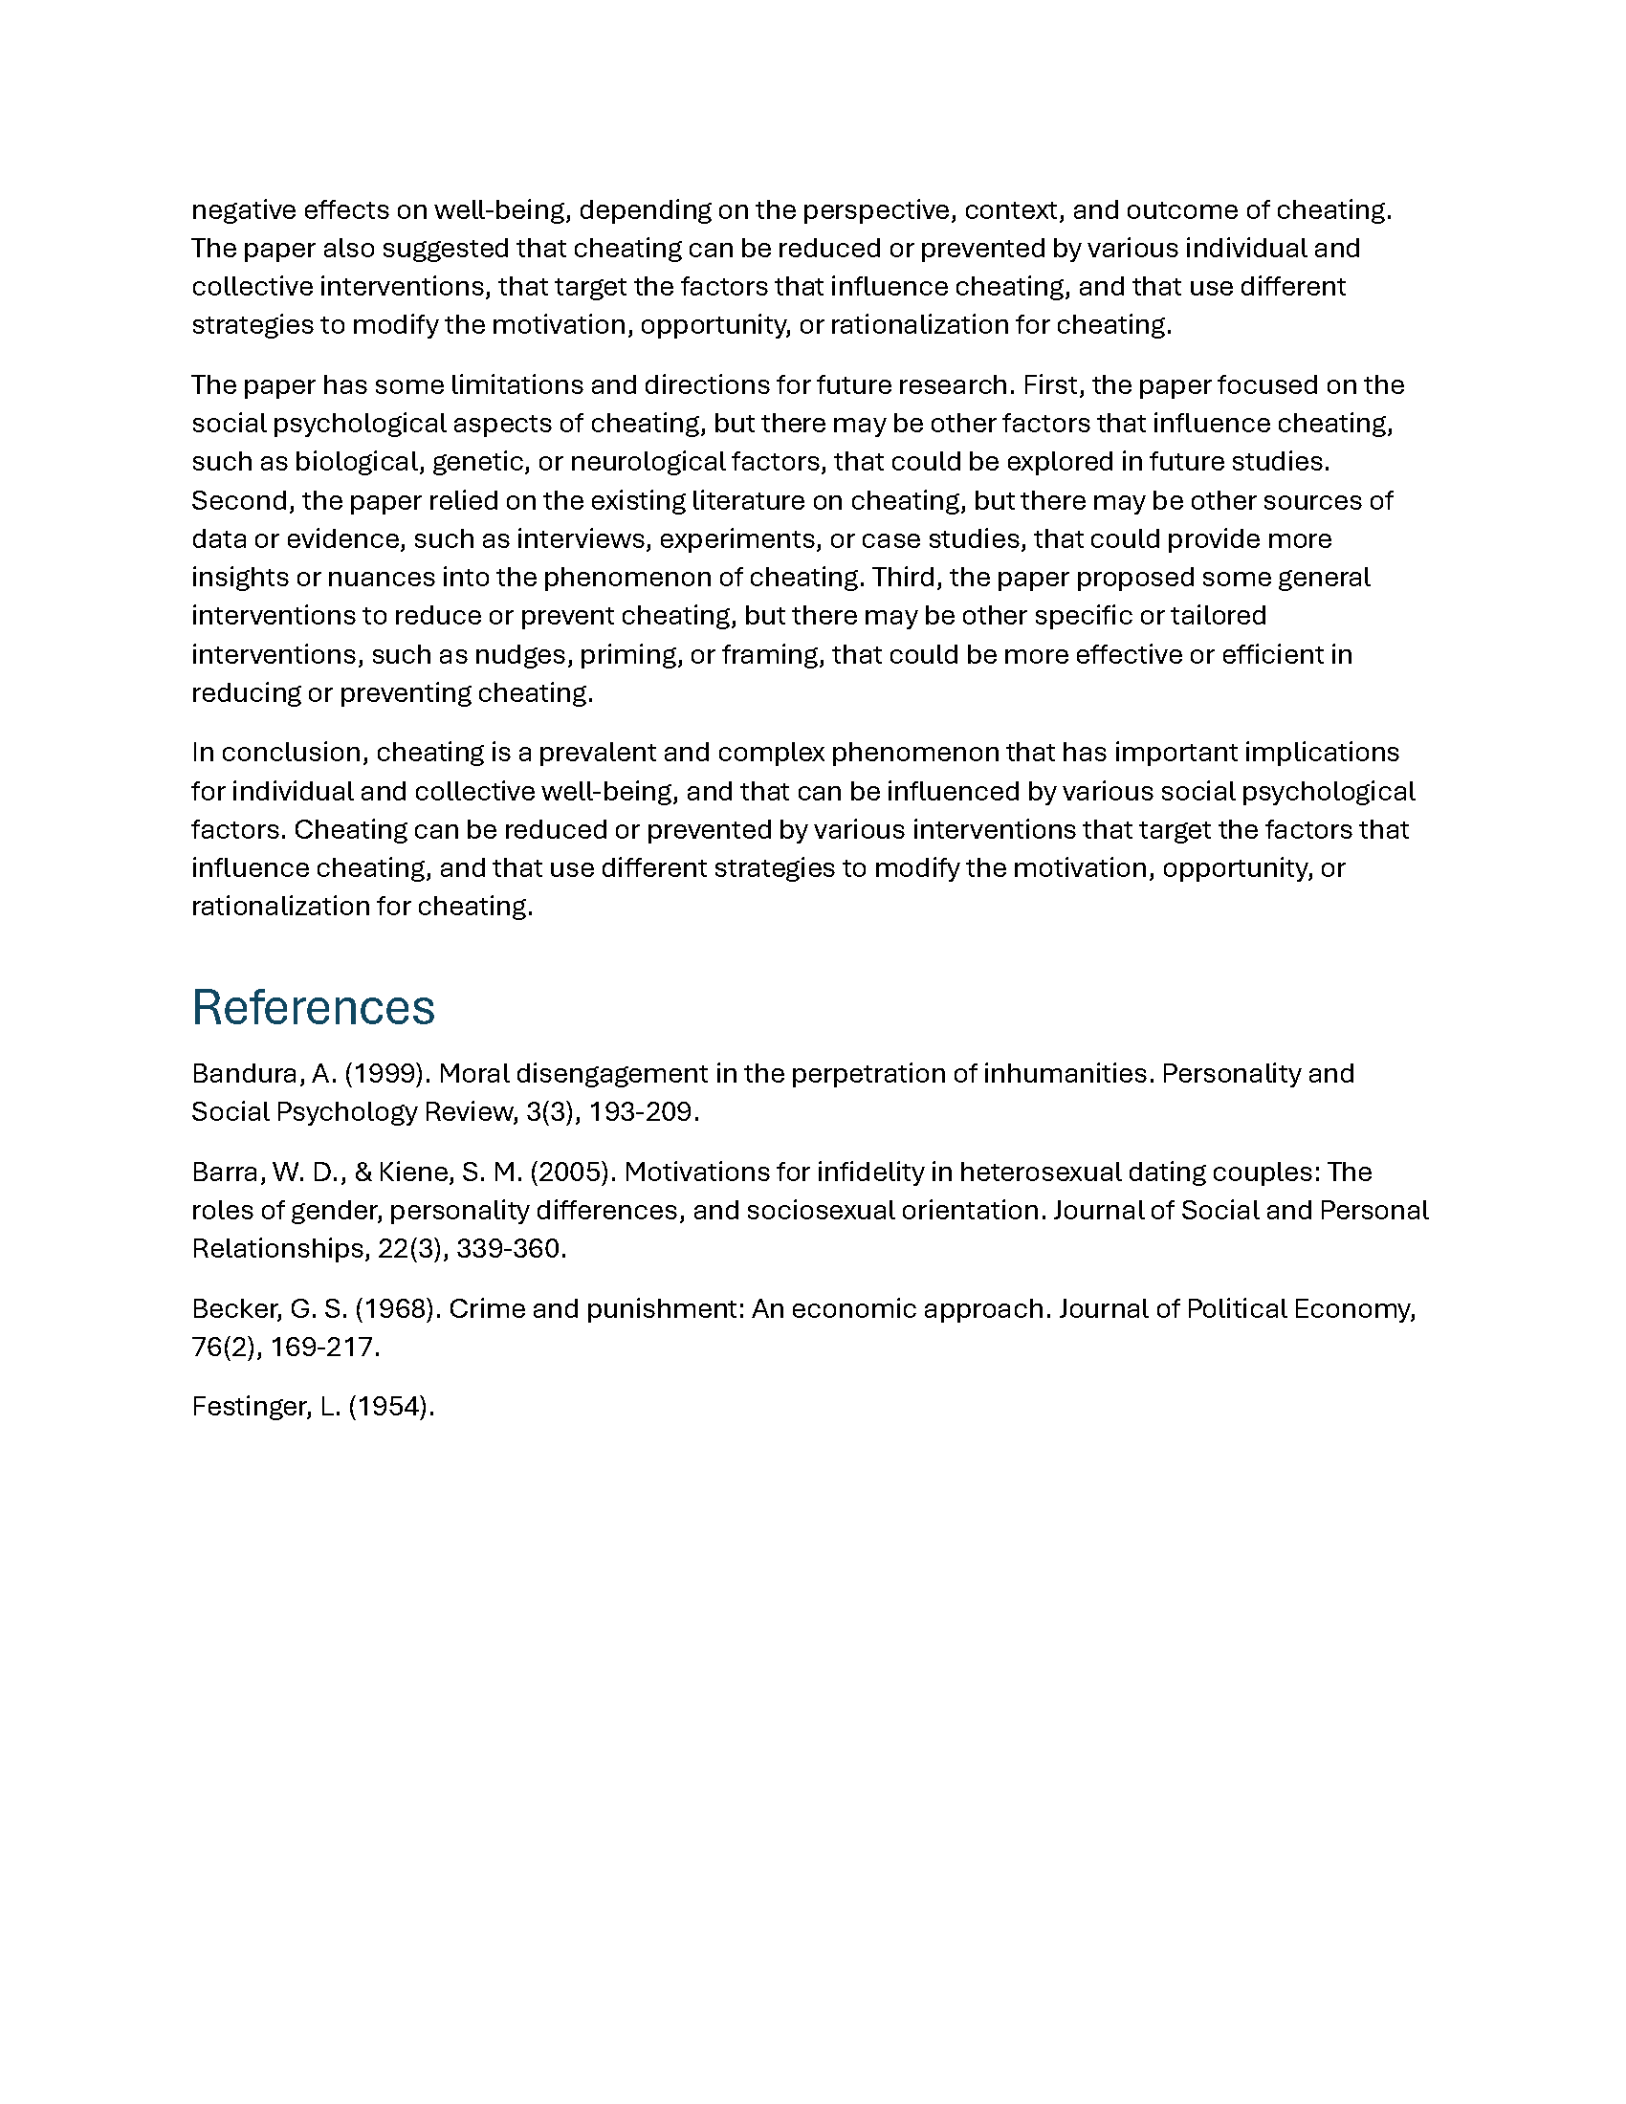
Word

Slide 6
The Problems
AI Can’t Count (10 pages, not 12)
Not Proper References
  Not Word References
  Missing Information
  Not Always On-Target
The first draft failed – perhaps because it referenced Ariely’s book
Notes:
Festomger (Leon) Cognitive Dissonance

Slide 7

Three Pillars
Employee Engagement
Content Access
Content Hygiene

Slide 8

Public Party Tricks
Notes:
Public generative AI (LLMs) are party tricks. They look good – but there’s a limit to what they can deliver.

Slide 9
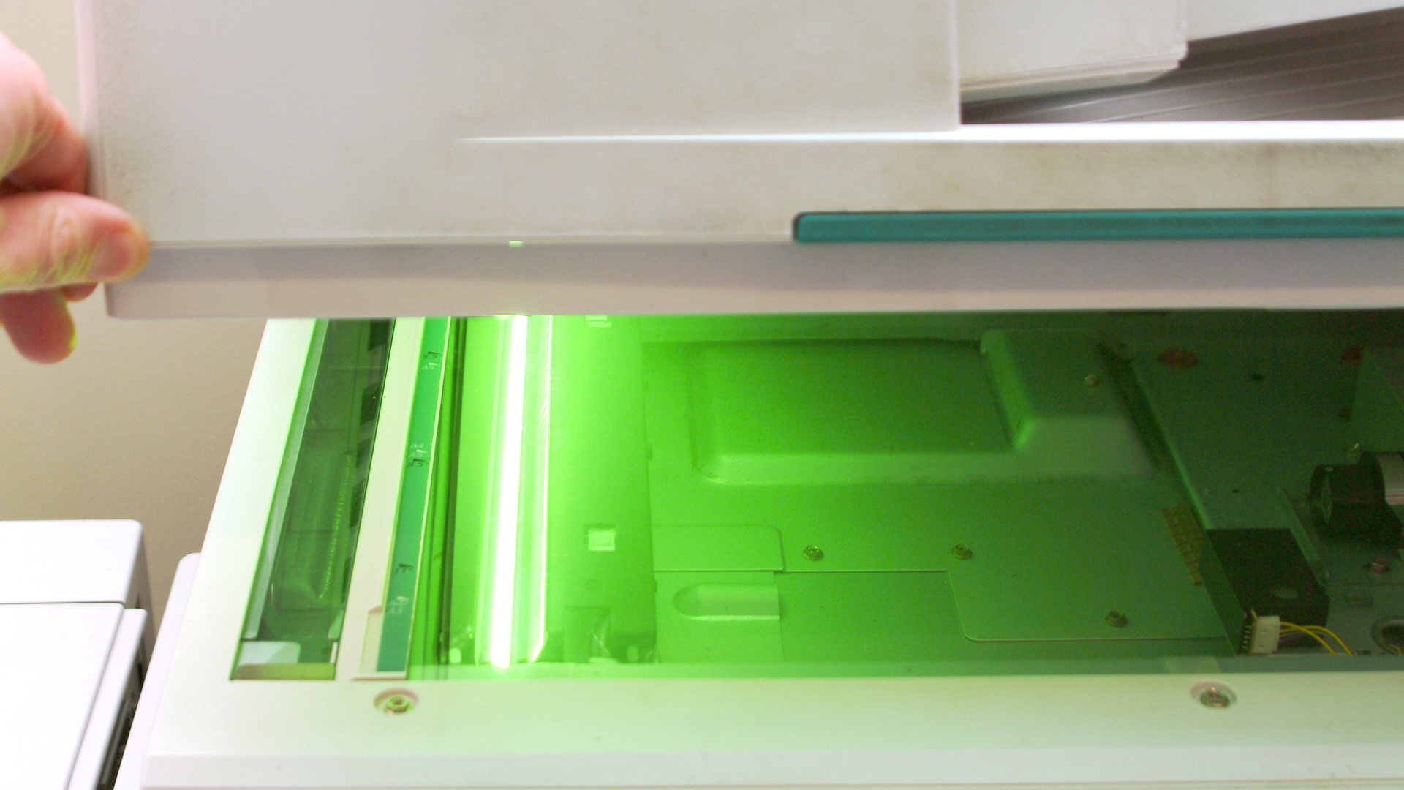
Plagiarism
Notes:
How do you know that what you’ve generated from a public AI model isn’t partially or completely plagiarized?

Slide 10

Fictional Sources

Slide 11

Powerful Advantage
Corporate
Content
Generative
AI

Slide 12
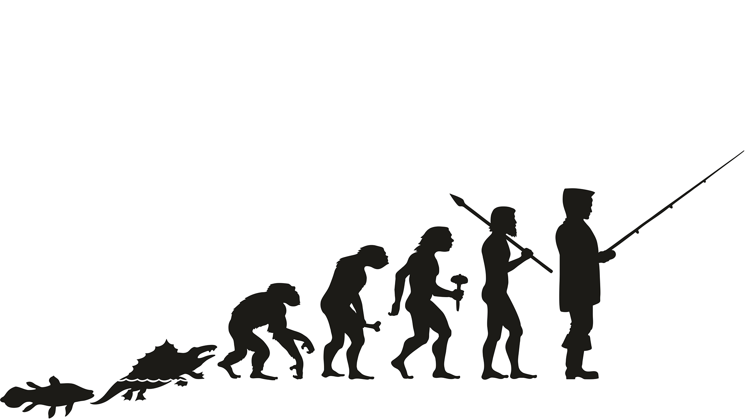
Evolution
Search
Social Network Analysis
Large Language Models

Slide 13

Employee Engagement

Slide 14

It’s Not About the
Technology
Today we buy services, not products
Service providers provide the technical expertise

Slide 15
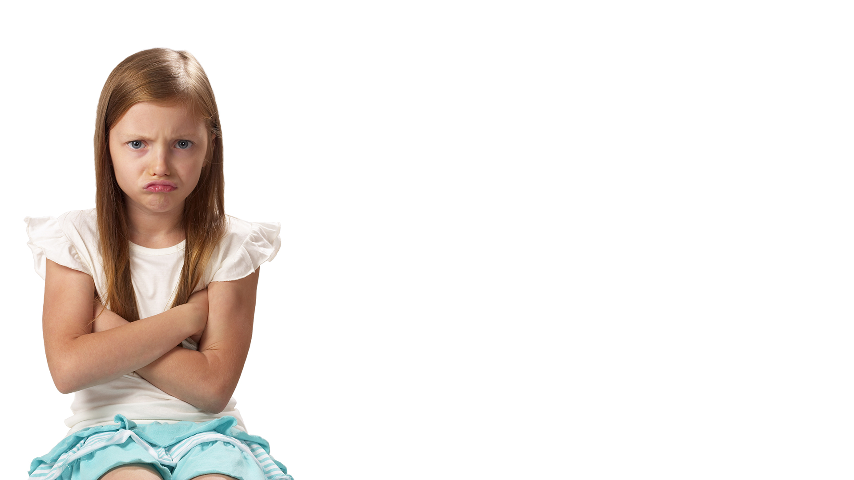
You Can’t Make Them

Slide 16

Handwashing Compliance Rates
Acute Care (Hospitals)
  Worldwide ~20%
  US ~50%-80%

Slide 17
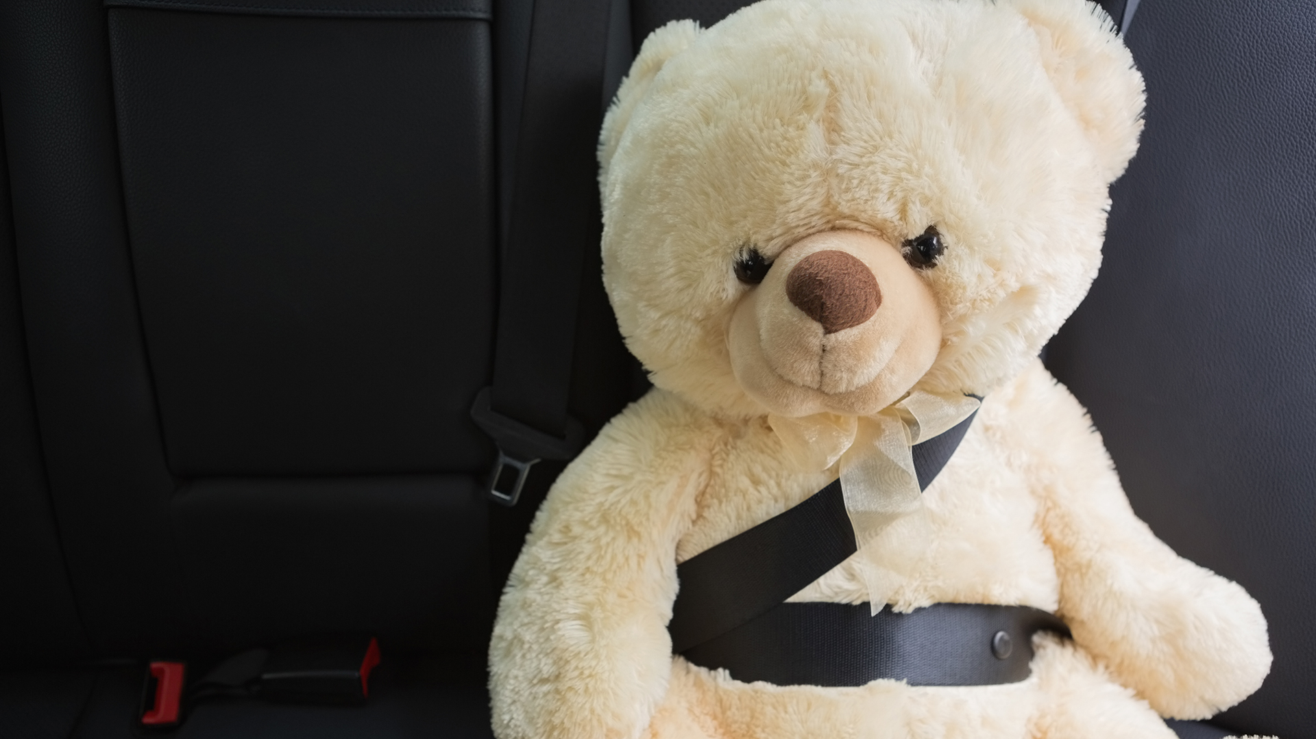
Seatbelts
Notes:
Ralph Nader wrote about the lack of safety in automobiles in “Unsafe at any speed.” That kicked off a push to make cars safer but decades after his book people still weren’t wearing seatbelts.

Slide 18
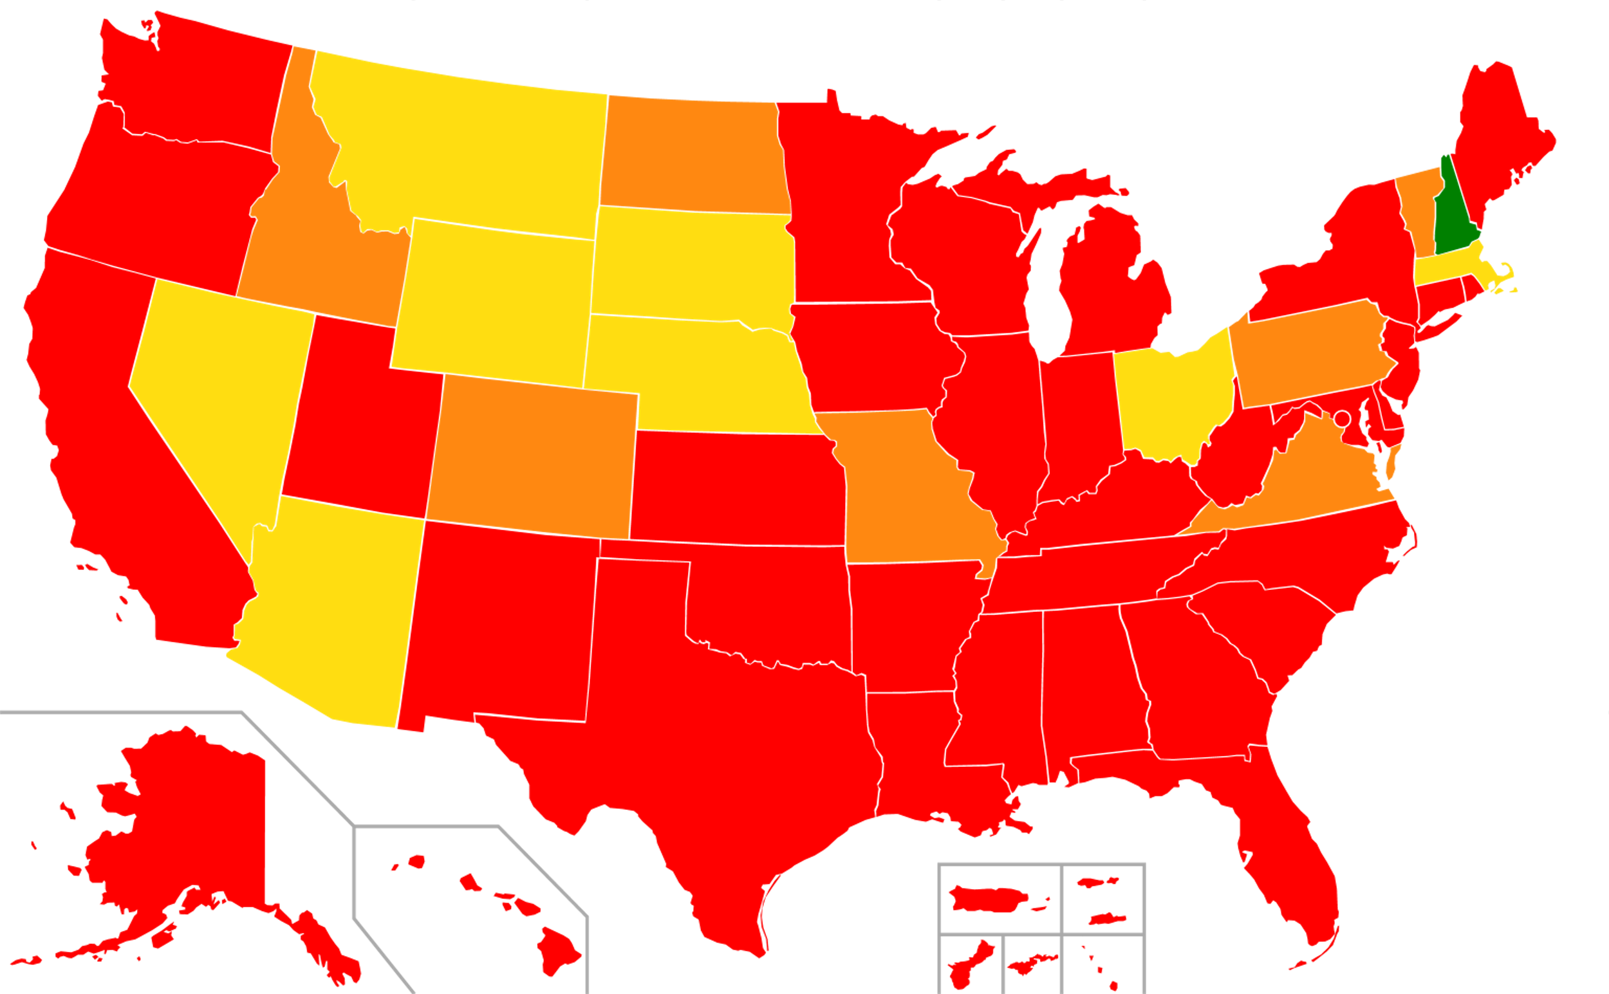
No enforcement for adults (primary enforcement for minors)
Secondary enforcement
Secondary enforcement; primary under certain ages
Primary enforcement

Slide 19
% Seat Belt Usage

Slide 20
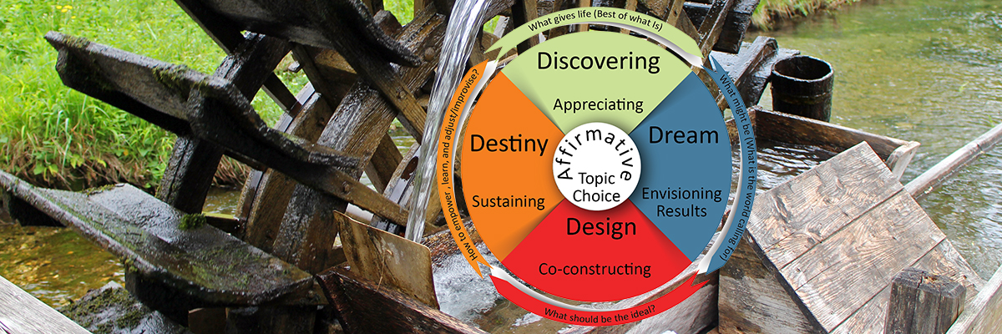

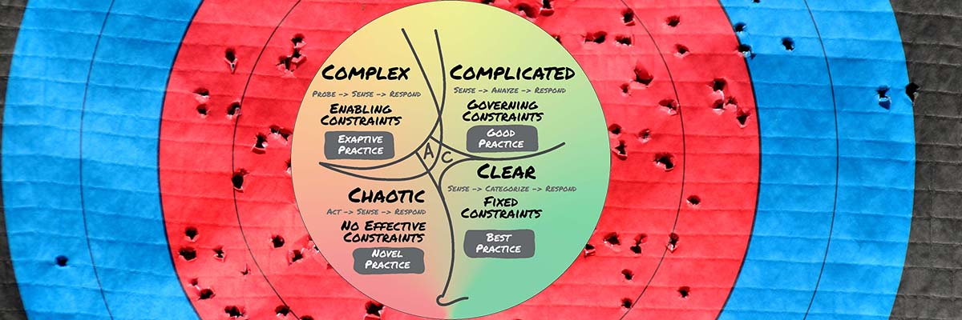
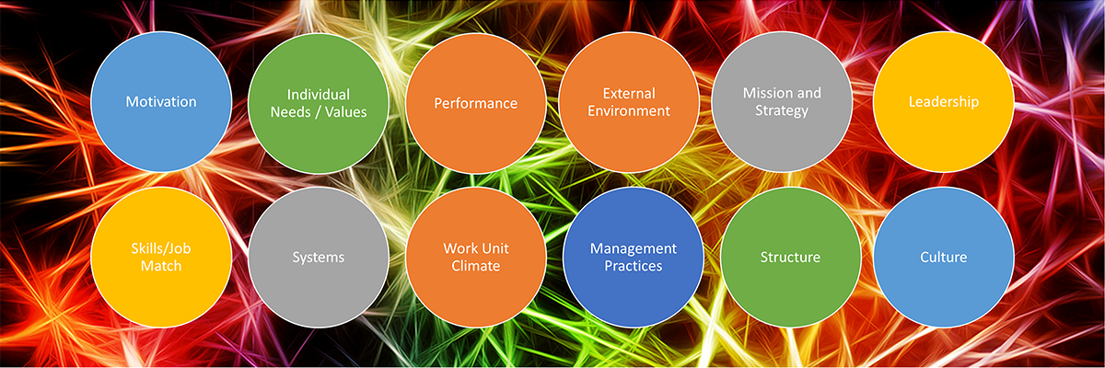

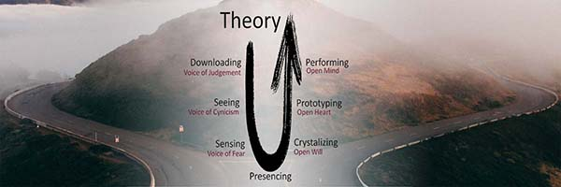
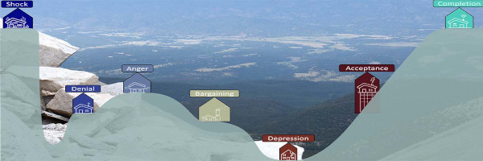
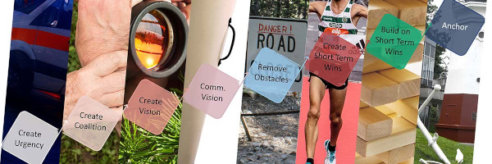
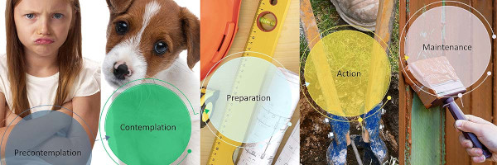
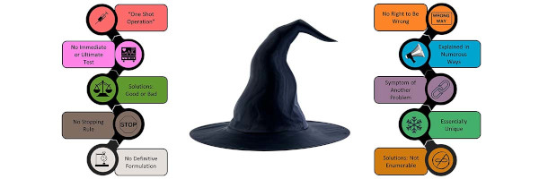




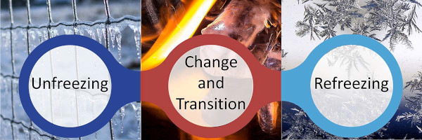
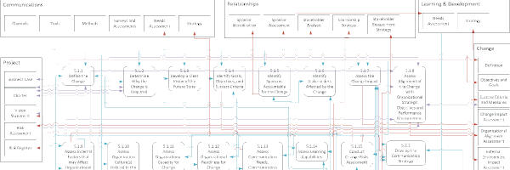
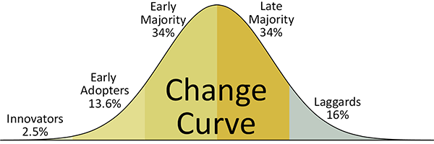
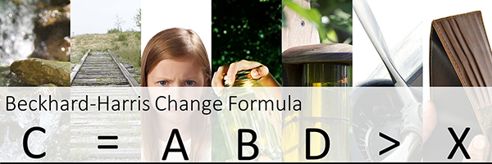
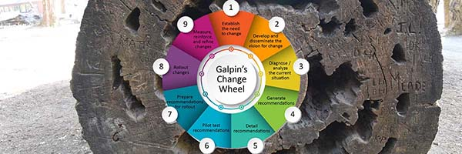
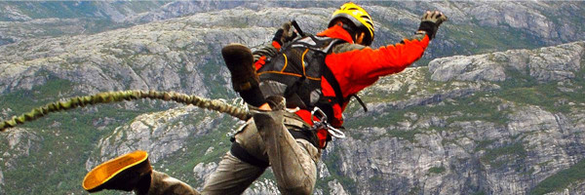
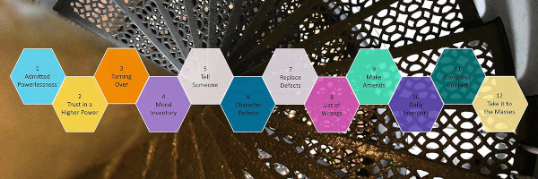
Pick a Model…
https://ConfidentChangeManagement.com/Change-Models

Slide 21

Content Access

Slide 22

Restrictions
Notes:
Before we get to what we can get to we need to cover the limits

Slide 23
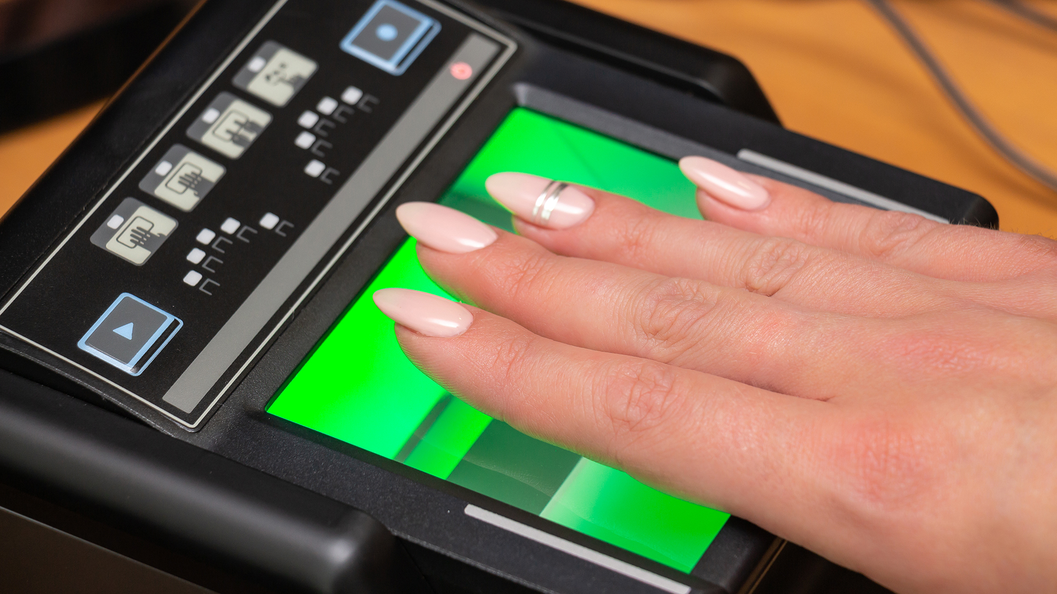
Identity
Notes:
One consistent identity across systems?

Slide 24
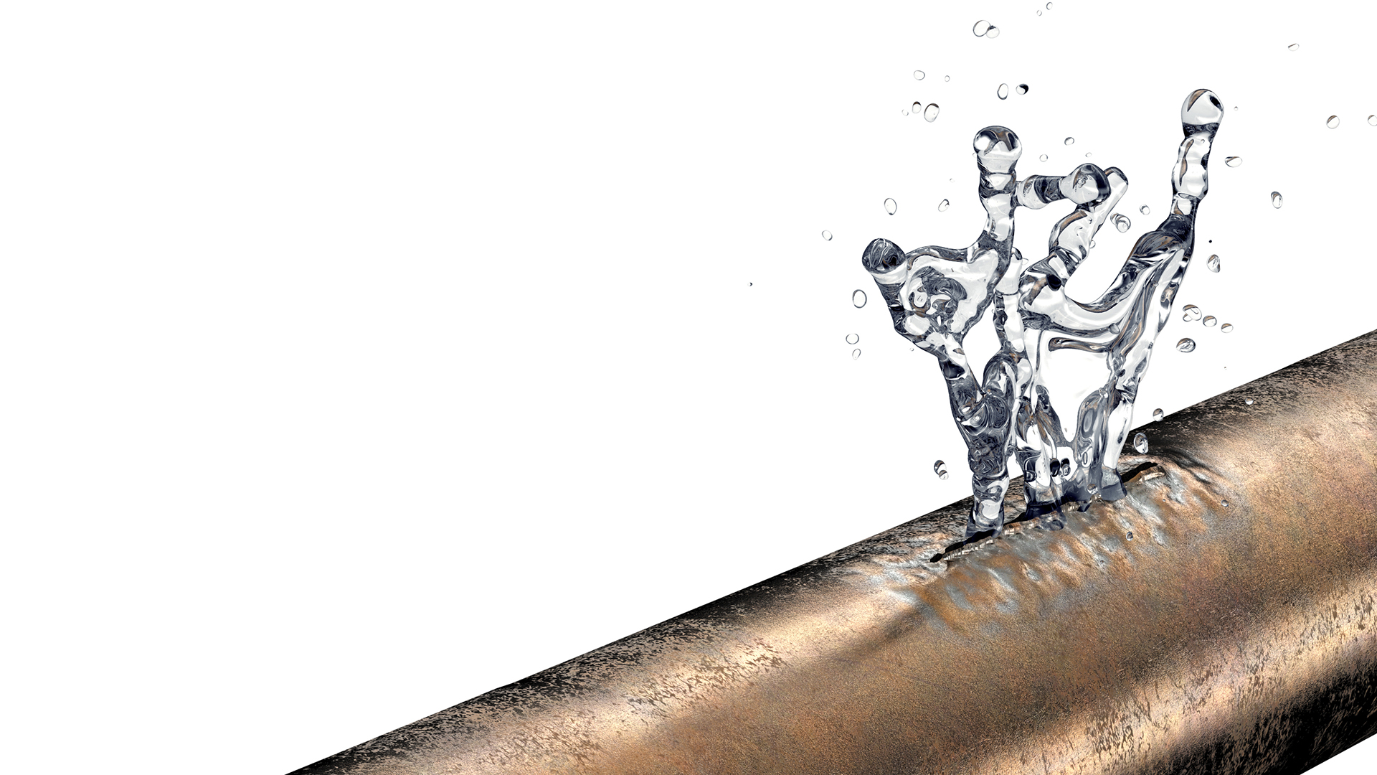
Sensitivity
Notes:
DLP What can you use?

Slide 25
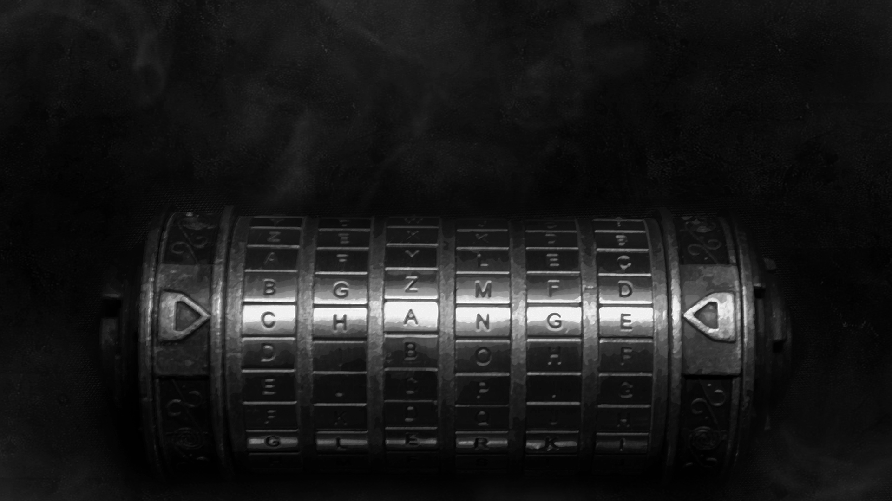
Permissions
Notes:
How do you ensure that the permissions for content – which aren’t always role based make it into the engine?

Slide 26
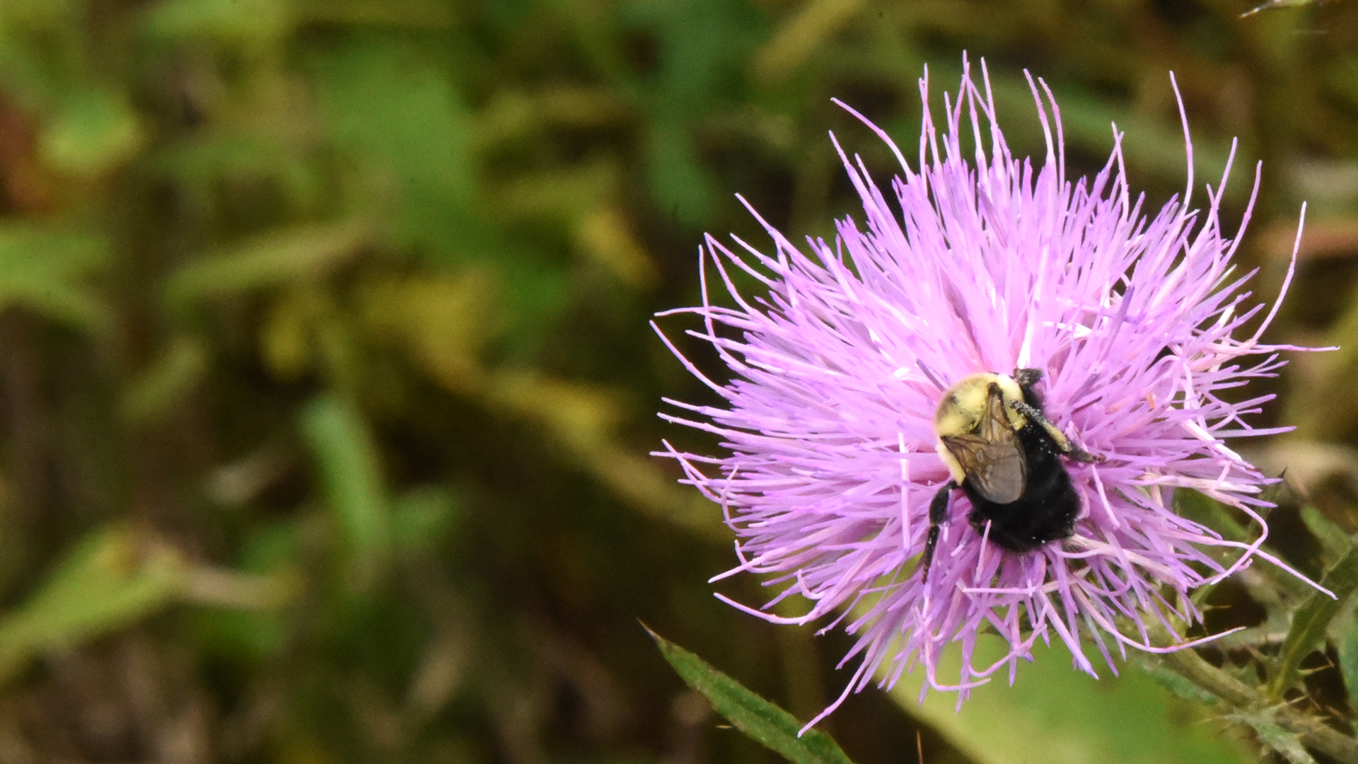
Content Crawling

Slide 27

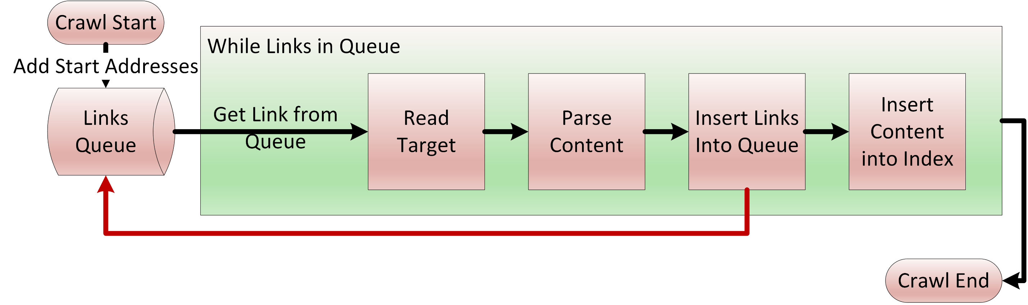
Crawling

Slide 28
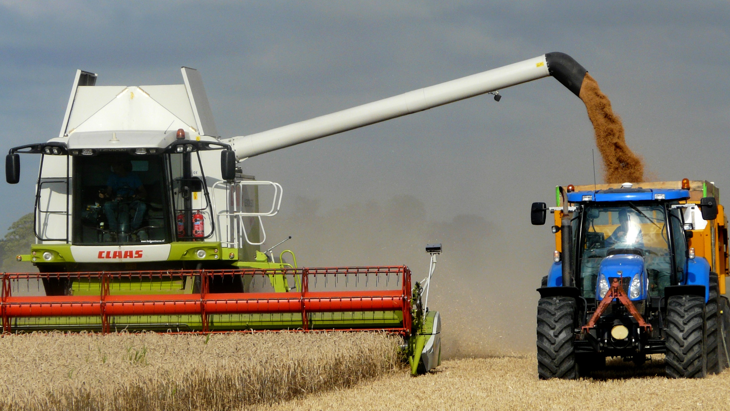
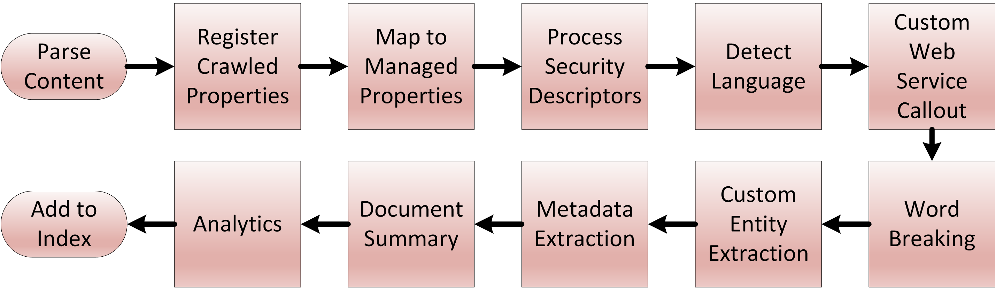
Content Processing

Slide 29

Content Hygiene

Slide 30
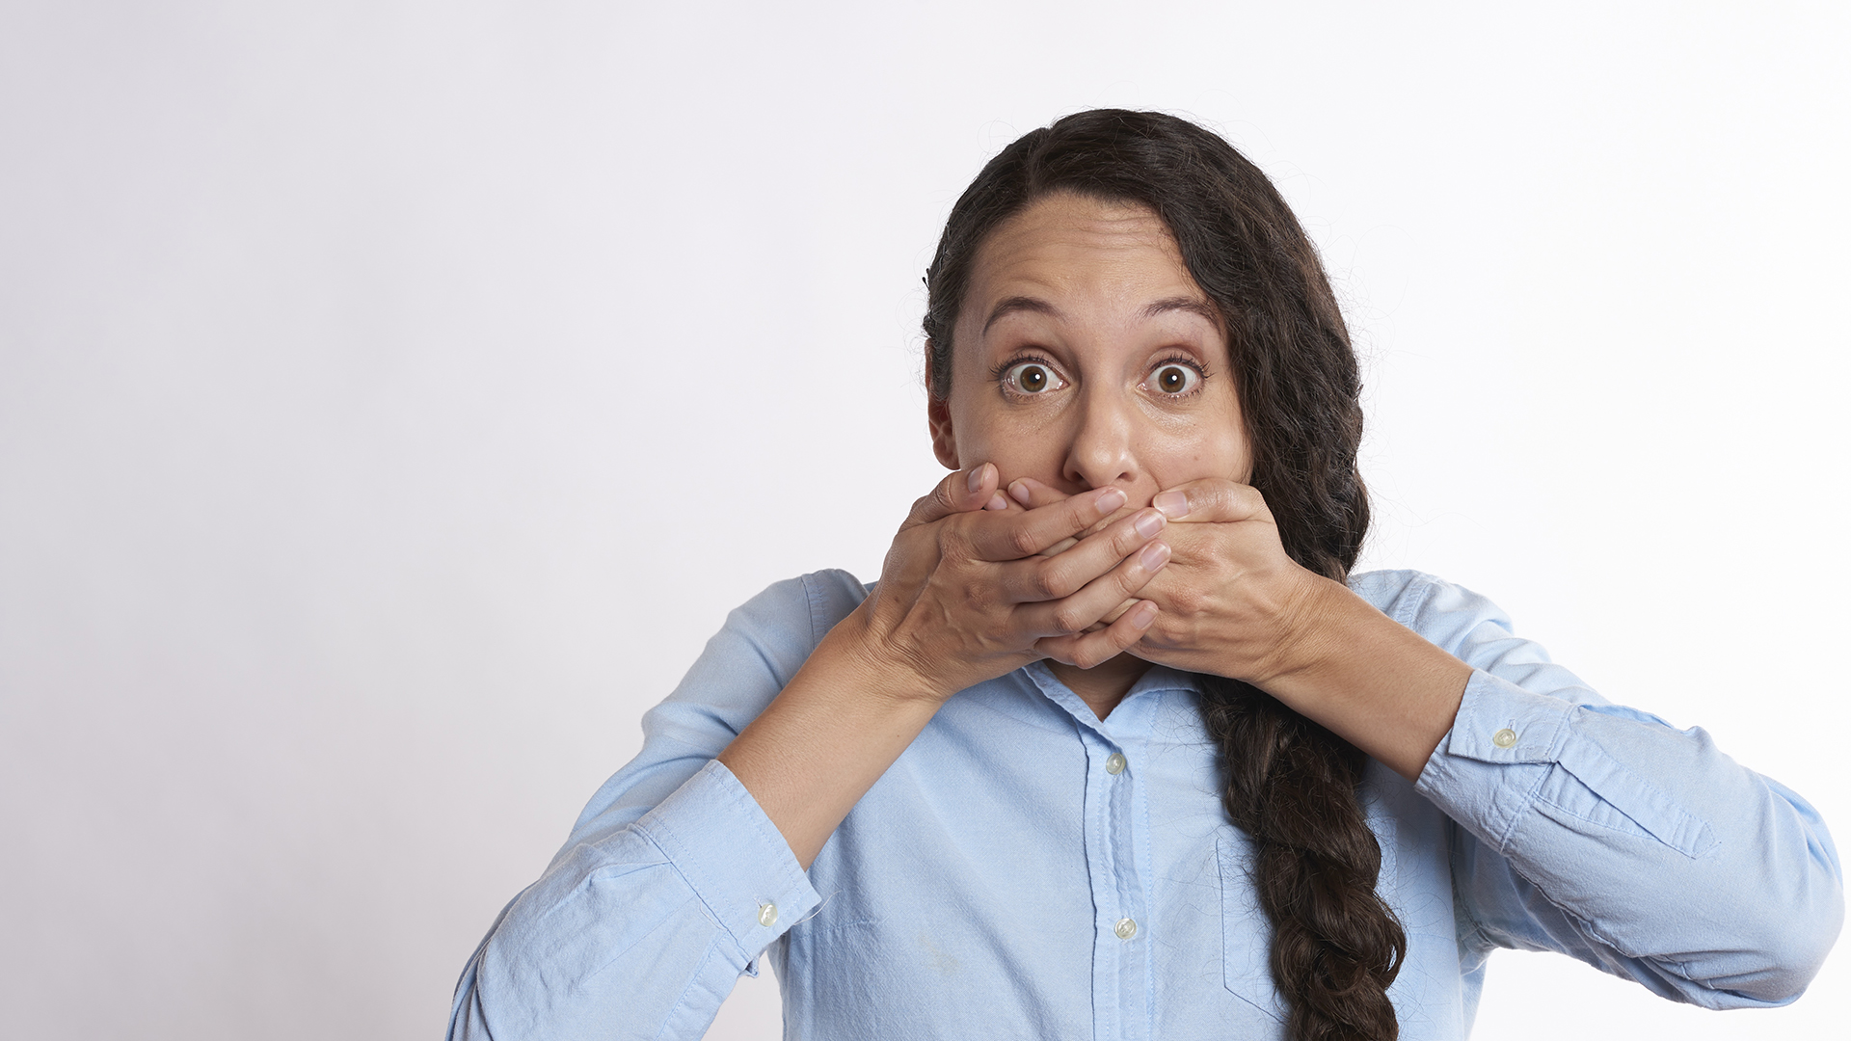
Inappropriate Language

Slide 31
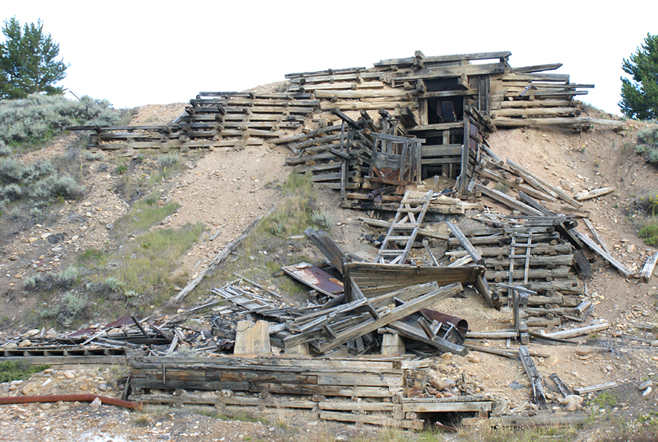
Redundant, Outdated, and Trivial (ROT)

Slide 32

Taxonomy

Slide 33

Metadata

Slide 34

Data Catalog

Slide 35

Conclusion

Slide 36

Conversations

Slide 37
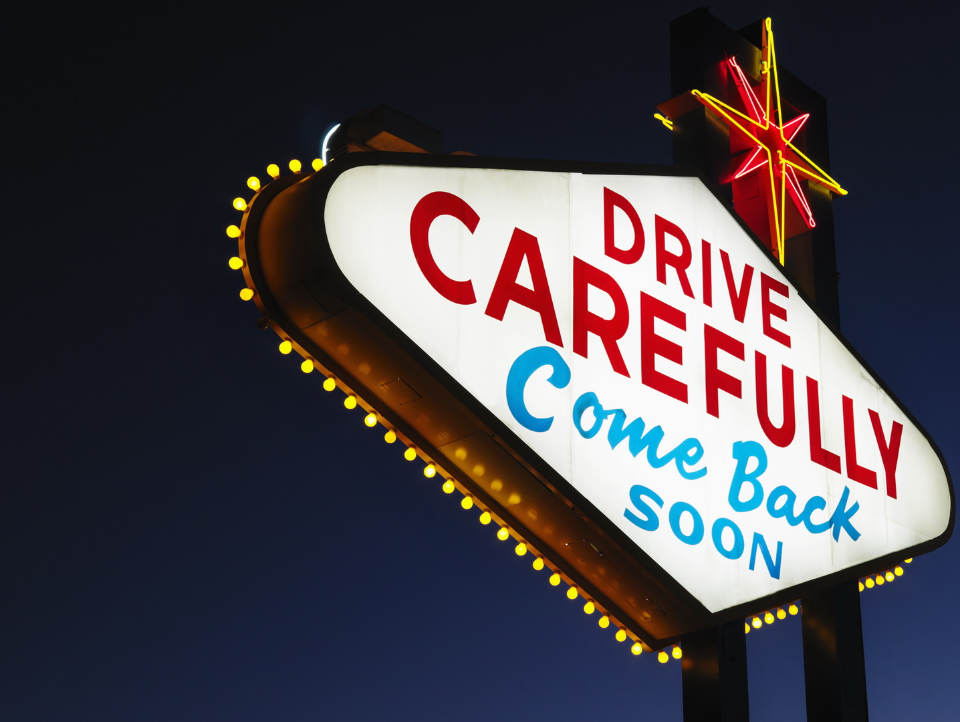
Thank You, Questions?
Robert Bogue
Rob.Bogue@ThorProjects.com
(317) 844-5310
https://ThorProjects.com
https://ConfidentChangeManagement.com
https://ExtinguishBurnout.com
https://ChangeInspired.com
https://RobustFutures.org

