Slide 1

ARMA Chicago Spring Seminar
May 24th 2022

Slide 2

Today’s Program
Connect – Let’s say hello to our colleagues, it’s been a long time since we’ve met in person!
Skills to Succeed – Let’s talk about the skills we need to develop or the skills we need to gain to navigate the changing landscape of the Records Management and Information Governance fields.
Tera Ladner
Leela Yellesetty
Robert Bogue
Thanks to our Sponsors
R4
GRM
East Bank

Slide 3

ARMA Chicago Sponsor
Karen Rugai Moran
773-843-3900
krugai@r4services.com

Slide 4
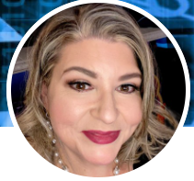
Kickoff Presentation
Tera Ladner
JD, CRM, IGP
VP, Information Risk Management & Governance, Aflac Inc.
Driving Change
“Ride the waves” of success in change management
Notes:
Our first speaker today is Tera Ladner. Tera is the Vice President for Information Risk Management & Governance at Aflac Inc, and was a past president of ARMA International. Focusing today on the critical skill of change management -- for those of us who struggle to drive change, Tera will share how to “ride the waves” of interest to further your objectives by “taking small bites of the elephant”. Please welcome Tera, thanks.

Slide 5

ARMA Chicago Sponsor
Michelle Paluch
312.604.7428
mpaluch@pmdchicago.com

Slide 6

Next:
Leela Yellesetty
Information Governance Officer at the Oregon Department of Environmental Quality
Information Governance
Skills to lead program transitions
Notes:
Our next speaker is Leela Yellesetty, who is the Information Governance Officer at the Oregon Department of Environmental Quality. Leela’s skills focus is on the transition from a RIM program to an Information Governance program, and thinking through what skills we need to succeed.

Slide 7
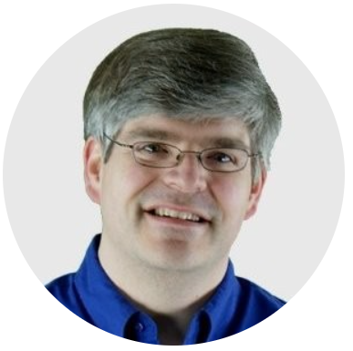
Our last speaker
Robert Bogue
President and CEO of Thor Projects LLC
Information Governance
How the different set of perspectives, skills, and roles enable organizational effectiveness.
Notes:
Our last speaker today is a friend of the Chicago chapter who has joined us previously and we’re glad to have return to our city. Robert Bogue is President and CEO of Thor Projects LLC. Today Robert is zooming out to show us the big picture of Information Governance, how the different set of perspectives, skills, and roles enable organizational effectiveness.

Slide 8

Join ARMA!
Grow your professional network
Develop your skills
Contribute your knowledge
Have fun

