Slide 1



Navigating the
AI Frontier
Empowering Information Governance and Records Management Professionals for a Responsible Future
Kate Elgayeva, PhD | KNE Consult | May 2024

Slide 2

300%
AI spending growth in 2023
94%
of workers say they are ready to learn new skills to work with gen AI
5%
of orgs actively reskilling their workforce at scale
RAMP 2024, Accenture 2024

Slide 3


60%
of leaders worry their organization’s leadership lacks a plan and vision to implement AI
65%
of executives admit not having the skills necessary to lead the GenAI transformation
Udemy 2023, Accenture 2024

Slide 4


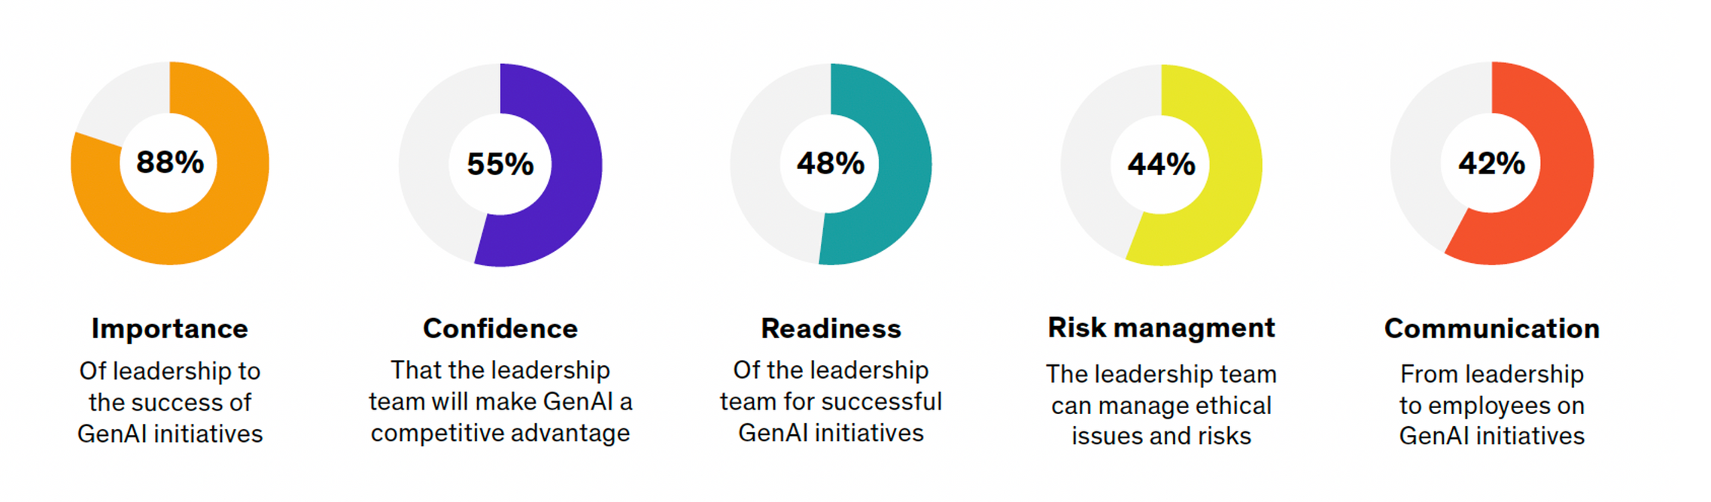
AI Transformation Readiness
Udemy 2024

Slide 5
Barriers to AI Readiness
So far, 10% of organizations globally have scaled GenAI within operations…
Uncertainty
Complacency
Ethics and governance
Resources
55% of the global workforce uses GenAI at least once a week
Oliver Wyman Forum 2024
Notes:
Without a roadmap to guide their teams through change and the skills to do so effectively, leaders risk loss of competitive advantage….

Slide 6
Changing Landscape
Leaders recognize the value of bringing on new employees with AI aptitude, but are not preparing them for success
Only 39% of global employees received AI training from their company
Only 25% of companies are planning to offer training on generative ai this year
Risks for IG, RM, and KM are exponentially amplified

Slide 7
Hybrid Skillset for the AI Era
Digital
Literacy
Essential
Soft Skills
Human-AI Collaboration
Ability to critically evaluate AI outputs and integrate with human expertise
Understanding AI capabilities, limitations, and ethical implications
Critical thinking
Creativity
Emotional intelligence

Slide 8

Cultivating Human-AI Collaboration
Critical Thinking
Validating AI outputs against policies, regulations, and business context
Creativity
Reimagining IG/RM processes and workflows augmented by AI
Emotional Intelligence
Managing workforce integration of AI tools and public perception

Slide 9
A Leadership Imperative
Learning in the flow of work
Creating a continuum
Building a network bridge
Immersing in active experimentation to shift mindsets and skillsets
Gaining buy-in to scale gen AI and lead responsibly
Earning trust to reinvent work and reshape the workforce

Slide 10
Human Capital
upskilling investment should exceed technology investments
Closing Skill Gaps
socio-technical skills as differentiators for collaborative work in the future
A Knowledge Imperative
Learning Initiatives
aimed at ensuring readiness for large scale transformation
Social Capital
how work and work processes could be transformed for the better

Slide 11
Key Opportunities
Shaping
AI Development and Deployment
Enabling Transparency and Accountability
Upholding
Employee Rights and Empowerment
Contribute expertise in data governance, information lifecycle management, and ethical data use
Ensure AI systems align with organizational policies, standards, and best practices
Participate in AI governance and oversight processes
Advocate for transparency in AI system design, training data, and decision-making
Implement controls for responsible data collection, use, and protection
Facilitate audits and assessments of AI systems' compliance and impact
Safeguard workers' privacy, employment rights, and non-discrimination protections
Foster worker awareness, education, and participation in AI adoption
Ensure AI systems complement and enhance workforce capabilities

Slide 12
Dynamic Challenges
Navigating Evolving Regulatory Landscape
Fostering Cross-Functional Collaboration
Aligning AI governance with diverse legal and ethical frameworks and keeping pace with changing guidelines
Bridging knowledge gaps between teams and coordinating governance across organizational siloes and domains
Managing AI Data Complexity and Scale
Promoting Ethical
AI Adoption
Ensuring data quality, integrity, and lineage for AI training and operations and establishing retention schedules
Addressing biases and balancing innovation with responsible use to cultivate trust and acceptance among stakeholders

Slide 13
Minding the Trust Gap
DATA GOVERNANCE
Sum of the risks (real and perceived) associated with AI
EXPLAINABILITY
Persistent nature of the AI trust gap despite ability to mitigate risks
FAIRNESS
Invest in understanding the risks and work to mitigate those risks
PRIVACY
Humanizing the process = most essential risk management tool
SECURITY
TRANSPARENCY

Slide 14
Transparency and Trust
AI Safety and Security for implementation of AI infrastructure (OpenAI, Nvidia, Microsoft, Google)
Biden’s Executive Order on Safe, Secure, and Trustworthy AI
EU AI Act will enforce certain transparency standards
Significant lack of standardization in responsible AI reporting
National Institute of Standards and Technology’s AI Risk Management Framework is paving the way
Regulation and enforceability is nascent
US Department of Labor established AI Principles for Developers & Employers

Slide 15
Mitigating the AI Trust Gap
Boundary spanning to map knowledge flows
Collaboration
Leadership
Governance
Alignment
Developing deep domain knowledge
Building governance ecosystem
Mapping internal neural networks

Slide 16


Balancing AI Gains with Alignment
AI alignment = process of ensuring that AI systems act in ways that are consistent with human values and ethics
POLICY DEVELOPMENT
PROCESS CODIFICATION
DATA CURATION
REGULAR AUDITING
FEEDBACK LOOPS
NETWORKED KNOWLEDGE

Slide 17

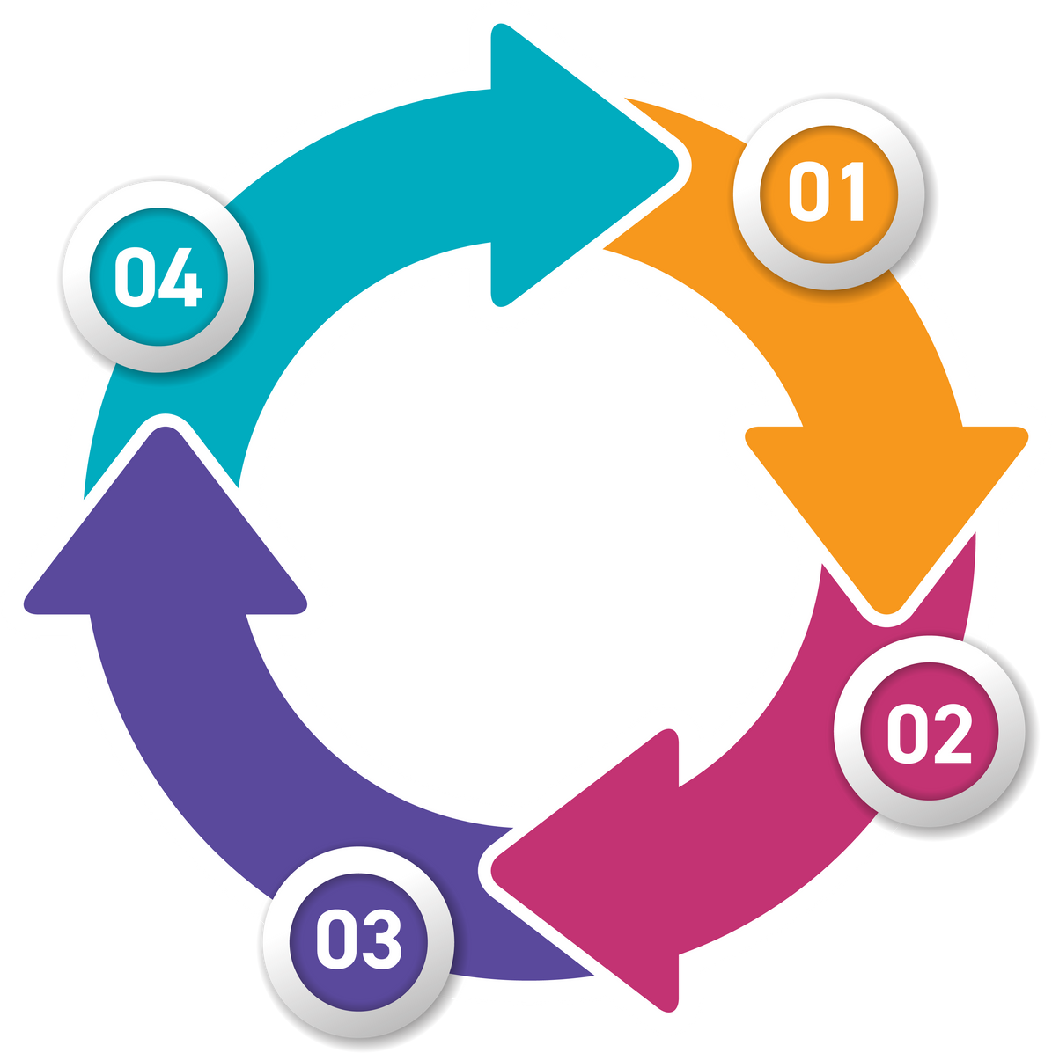
Getting Started Responsibly
Build the Human-Tech Stack
Develop Digital Literacy
Cross-functional community of practice for adoption oversight
Socio-technical and domain-specific upskilling and training
Perform Data Dive
Identify and Rank
Audit infrastructure and ecosystem to assess impact
Focus on key data sets and processes AI can optimally support

Slide 18

Leadership
WHO
Who is leading AI governance efforts NOW, and what would it look like to elevate the conversation to the C-suite? Who should be involved?
Opportunity
WHAT
What is the opportunity cost of not getting AI governance right in terms of missed upside, extensive time in manual processes, or suboptimal business decisions?
AI Domains
WHERE
Where AI governance most important? What domains and parts of domains does the organization most need right now?
AI Framework
WHICH
Which AI governance archetype / framework best fits the organization, and are current efforts aligned to that level of need?

Slide 19
The Human-AI Continuum
Scaling responsible AI is a continuous process for IG and RM leaders
Synergy between human and machine yields new frontiers for the way we work and create impact
Cross-functional collaboration and relational coordination are keys to social capital formation
Purpose of technology remains to serve and enhance human endeavors
Technology advancement requires us to tap into the depths of our human nature

Slide 20
Thank You!
kneconsult.com

