Slide 1
Skills to Manage Information Governance
ARMA Chicago Chapter
10 February 2015
Carol E.B. Choksy
Adjunct Lecturer
Department of Information and Library Science
School of Informatics and Computer Science
Indiana University, Bloomington

Slide 2
Learning Objective
  Develop an education and opportunities plan tailored to your personal career needs.
Notes:
Describe: 5 minutes

Slide 3
Information Governance Maturity Model
Accountability |  | A senior executive (or person of comparable authority) shall oversee the information governance program and delegate responsibility for records and information management to appropriate individuals. The organization adopts policies and procedures to guide personnel and ensure that the program can be audited.
Level 1 | Sub-Standard | No senior executive (or person of comparable authority) is responsible for the records management program. | The records manager role is largely non-existent or is an administrative and/or clerical role distributed among general staff.
Level 2 | In Development | No senior executive (or person of comparable authority) is involved in or responsible for the records management program. | The records manager role is recognized, although he/she is responsible for tactical operation of the existing program. |  | In many cases, the existing program covers paper records only. |  | The information technology function or department is the de facto lead for storing electronic information, but this is not done in a systematic fashion. The records manager is not involved in discussions of electronic systems.
Level 3 | Essential | The records manager is an officer of the organization and is responsible for the tactical operation of the ongoing program on an organization-wide basis. | The organization includes electronic records part of the records mas management program. | The records manager is actively engaged in strategic information and record management initiatives with other officers of the organization. | Senior management is aware of the program. | The organization envisions establishing a broader-based information governance program to direct various information-driven processes throughout the enterprise. | The organization has defined specific goals related to accountability.
Level 4 | Proactive | The records manager is a senior officer responsible for all tactical and strategic aspects of the program. | A stakeholder committee representing all functional areas and chaired by the records manager meets on a periodic basis to review disposition policy and other records management-related issues. |  | Records management activities are fully sponsored by a senior executive.
Level 5 | Transformational | The organization’s senior management and its governing board place great emphasis on the importance of the program. | The records management program is directly responsible to an individual in the senior level of management, (e.g., chief risk officer, chief compliance officer, chief information officer) OR, |  | A chief records officer (or similar title) is directly responsible for the records management program and is a member of senior management for the organization. |  | The organization’s stated goals related to accountability have been met.
The organization envisions establishing a broader-based information governance program to direct various information-driven processes throughout the enterprise.
Notes:
5 minutes
Emphasize Level 3 compliance overall, Level 5 for highly regulated business practices

Slide 4
Two Kinds of Information Silos
Departmental
Disciplinary
“Many organizations have traditionally used siloed approaches when managing information, resulting in decisions being made without sufficient consideration of information value, risk, or compliance for the organization as a whole.
Examples of these silos include the various departments or administrative functions within the organization that deal with the organization’s information, such as IT, Legal, Compliance, Records and Information Management, HR, Finance, and the organization’s various business units.
Each business unit or administrative function commonly has its own information governance policies and procedures, as well as disparate data systems and applications.”
“Another type of information silo consists of those disciplines that deal with specialized categories of information issues, such as data privacy and security (focused on protection of regulated classes of information), litigation e-discovery (focused on preservation and production of information in litigation), and data governance (focused on information reliability and efficiency).
Over time, these disciplines have developed their own terminologies and frameworks for identifying issues and addressing specific information challenges.”
The Sedona Conference® Commentary on Information Governance December 2013
https://thesedonaconference.org/download-pub/3421
Notes:
5 minutes
https://thesedonaconference.org/download-pub/3421
Data privacy
Information security
Litigation e-discovery
Data governance
Records management
IT
Compliance
Write one sentence beside each of these in section marked “Organization” describing what your organization needs
Write a brief sentence beside each of these in section marked “My career” describing what skills you believe you need to boost to help your career.

Slide 5
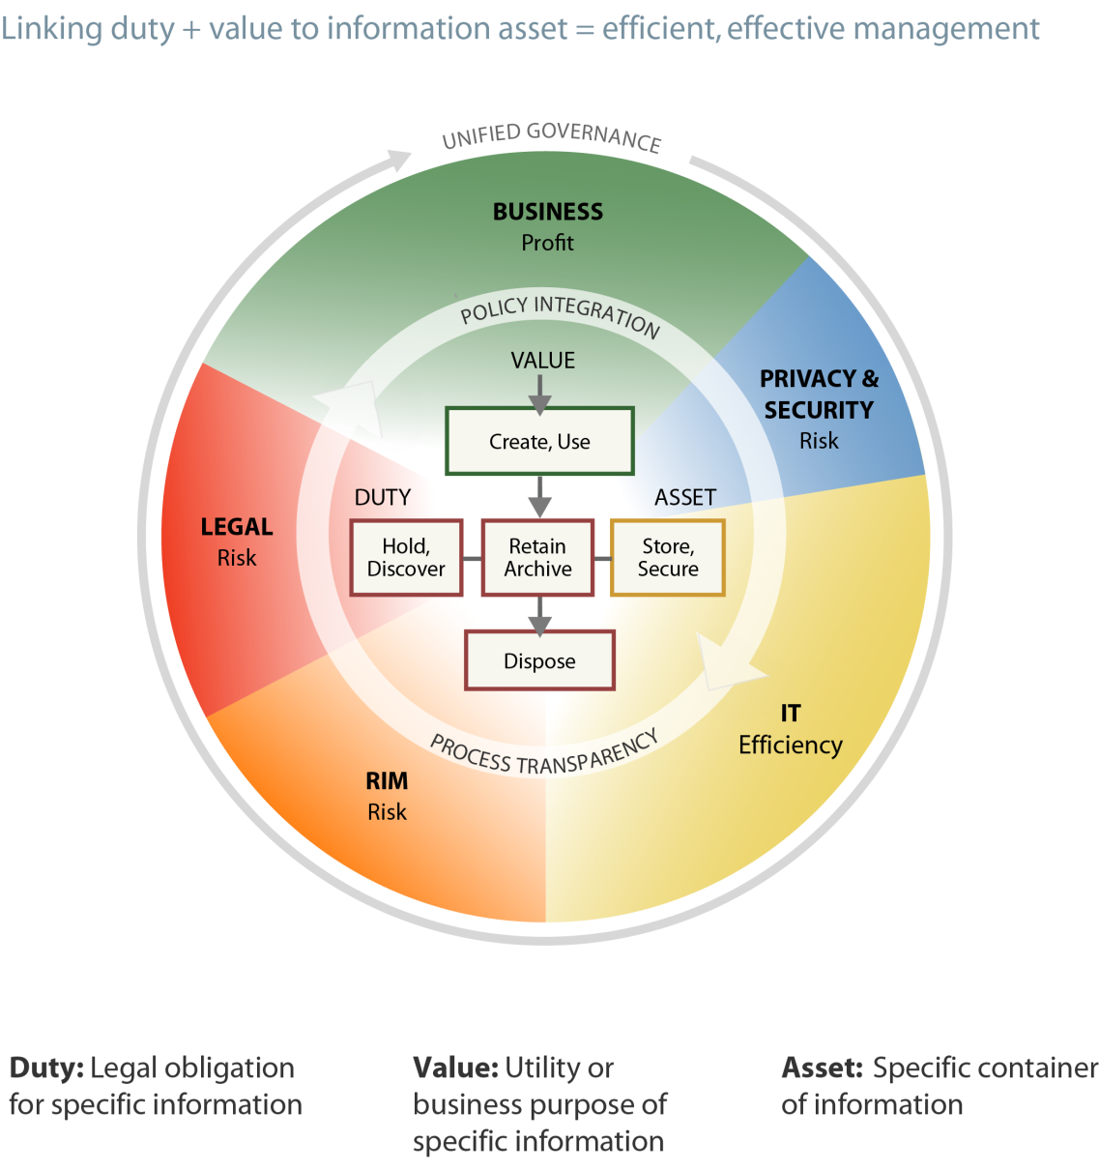
Information Governance Reference Model (IGRM)
http://www.edrm.net/projects/igrm
Notes:
Group discussion: 10 minutes

Slide 6
 | Accountability | Transparency | Compliance | Integrity | Availability | Protection | Retention | Disposition
Review & Revise Goals | ☻ | ☻ | ☻ | ☻ | ☻ | ☻ | ☻ | ☻
Remove Disciplinary Silos for Information-driven processes | ☻ |  |  |  |  |  |  | ☻
Business |  | ☻
Review & Adjust RRS |  |  |  |  |  |  | ☻
Disposition |  |  |  |  |  |  |  | ☻
Records & Information |  | ☻ | ☻
RFI |  | ☻ | ☻ |  | ☻
FOI |  | ☻ | ☻ |  | ☻
Discovery |  | ☻ | ☻ |  | ☻
Hold |  |  | ☻ |  |  |  |  | ☻
Regulatory |  | ☻ | ☻ |  | ☻
New IT System Introduction |  |  |  | ☻
Authenticity |  |  |  | ☻
Metadata Introduction |  |  |  | ☻
Chain of Custody |  |  |  | ☻
Audit |  | ☻ | ☻
Continuous Improvement |  |  | ☻ |  | ☻ |  |  | ☻
Notes:
Describe: 10 minutes
Writing: 20 minutes
For each yellow smiley-face (Level 3) write one sentence beside each of the processes in section marked “Organization” describing what your organization needs. Do the same for the Blue (Level 4) and Green (Level 5).
For each yellow smiley-face write one sentence beside each of the processes in section marked “My career” describing what skills you believe you need to boost to help your career. Do the same for the Blue (Level 4) and Green (Level 5).

Slide 7
Information Governance Maturity Model Levels for
IG Tools
IG Tool | Principle | Level it first shows up
Access controls | Protection | 3
Accountability | Accountability | 2
Audit | Compliance Integrity Protection | 4 5 3
Business code of conduct | Compliance | 3
Continuous improvement | Compliance Protection | 5 5
Corrective action | Compliance | 4
Documentation | Transparency | 3
Goals | All | 3
Measurement | Compliance Availability | 3 5
Process Transparency | Transparency | 2
Standardization | Accountability Retention Disposition | 3 5 5
Systems & software | Transparency Compliance Integrity Protection Availability Disposition | 5 4 4 4 3 5
Notes:
Describe: 10 minutes
Table discussion: 10 minutes
Tables report: 15 minutes
Writing: 15 minutes
Table discussion: How do these work?
Tables report their discussion
Writing: Describe the IG tools your organization has. Name the Level of each tool using the IGMM

Slide 8
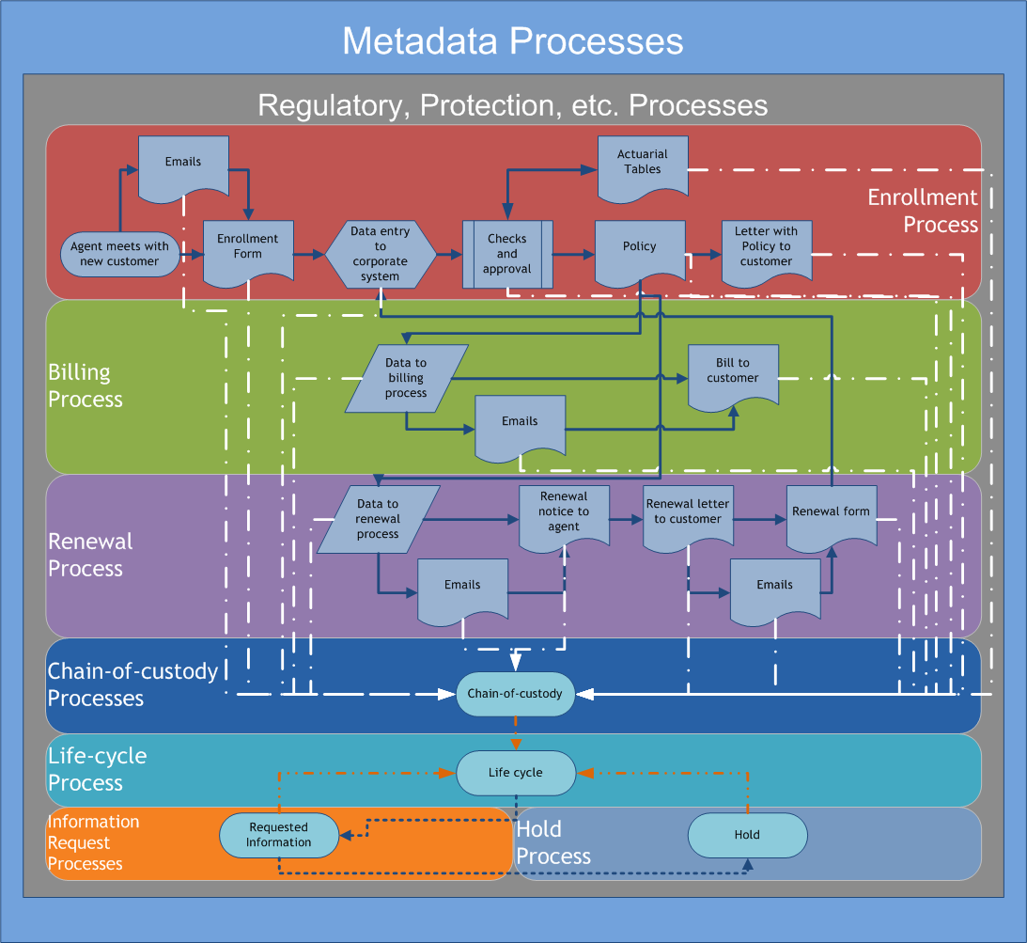
What other processes do we need to document?
Review & Revise Goals
Remove Disciplinary Silos for Information-driven processes
Review & Adjust RRS
Disposition
New IT System Introduction
Audit
Continuous Improvement
Notes:
Describe: 20 minutes

Slide 9
Information Governance Professional
Certified Information Governance Professional creates and oversees programs to govern the information assets of the enterprise.
The IGP partners with the business to facilitate innovation and competitive advantage, while ensuring strategic and operational alignment of business, legal, compliance, and technology goals and objectives.
The IGP oversees a program that supports organizational
  profitability,
  productivity,
  efficiency, and
  protection.
Notes:
Describe: 5 minutes
General discussion: 5 minutes

Slide 10
IGP DACUM
Information Governance Professional
Develop A CurriculUM

Slide 11
Inward-Facing Activity & Strategy
To create “a multiplier effect on resources, making mutually reinforcing decisions, and developing processes that can propel organizations beyond the realities of today to the desired futures of tomorrow.”
  Ross Harrison. Strategic Thinking in 3D: A Guide for National Security, Foreign Policy, and Business Professionals. Washington, DC: Potomac Books, 2013.
Notes:
Explain:
Multiplier effect on resources: information and technology
Mutually reinforcing decisions: accountability and standardization
Developing processes: we discussed processes a lot

Slide 12
Areas of Mastery
Managing Information Risk and Compliance
Developing IG Strategic Plan
Developing IG Framework
Establishing the IG Program
Establishing IG Business Integration and Oversight
Aligning Technology with the IG framework
Notes:
Describe: 3 minutes

Slide 13

Understanding and mitigating information-related risks through such activities as
researching and monitoring legal, regulatory and industry-specific compliance requirements; and
creating and monitoring internal policies and procedures.
The IGP collaborates with stakeholders to determine acceptable risk levels, and
then designs and implements methods for measuring and monitoring the effectiveness of the organization's plan to mitigate its risk.
Develop a strategic plan that demonstrates an in-depth understanding of the organization's
business goals,
corporate culture,
financial resources, and
commitments
Manage Information Risk and Compliance
Develop IG Strategic Plan
Develop IG Framework
Establish the IG Program
Establish IG Business Integration and Oversight
Align Technology with the IG Framework
Establish the parameters of the organization's IG efforts, including
developing policies and standards the organization should meet;
defining the authority, roles, and responsibilities the organization must establish;
designing IG program communications and training; and
developing audit and enforcement mechanisms
to ensure the IG program can be measured, controlled, and improved.
Partner with IT leadership to understand
the organization’s technology landscape,
the ways technology is used by the business, and
how to align the IG and Technology teams’ strategies and operations, including hardware, software, and data lifecycle management.
The IGP also evaluates technology trends that affect IG and partners with IT to assess opportunities and threats.
Determine the IG program scope and goals, such as
identifying specific program components,
acquiring a mandate from executive leadership,
establishing reporting requirements,
assigning specific roles and responsibilities,
establishing specific program metrics and desired outcomes, and
implementing and managing the IG program.
Align the IG strategy and program to enhance
business goals,
needs, and
objectives.
The IGP works closely with business units to determine steps for implementing the IG program in their divisions and for ensuring it is
monitored and audited periodically to confirm the business is complying with changing laws and
to confirm the IG program does not impede the business goals.
Notes:
Describe: 10 minutes
KEEP IT SIMPLE!
Emphasize that these are skills, but they are also a project plan.
Are you ready to play IGP DACUM Bingo?

Slide 14
Get out your
IGP DACUM bingo card
Notes:
Take out your cards and let’s go!
These should be in your “My career” section of your binder.
We’re going to go through these in the next few slides in a different order to help you understand what they do.
For each skill you can perform, put a sticker
Nobody loses, everybody gets candy!

Slide 15
Collaborating and Monitoring
A. collaborates with stakeholders to determine acceptable risk levels, and then
A. designs and implements methods for measuring and monitoring the effectiveness of the organization's plan to mitigate its risk
D. acquiring a mandate from executive leadership
D. establishing specific program metrics and desired outcomes
E. The IGP works closely with business units
E. monitored and audited periodically to confirm the business is complying with changing laws and to confirm the IG program does not impede the business goals
F. Partner with IT leadership
Notes:
Describe: 5 minutes

Slide 16
Gather Information
A.1. Monitor legal and regulatory landscape
A.2. Identify internal and external compliance requirements
C.1. Conduct due diligence to identify standards to guide the IG framework
E.1. Define current state of business processes
E.2. Define current state of technology use in business process
F.1. Identify how technology is used in the business
F.2. Monitor technology trends
Notes:
Describe: 5 minutes

Slide 17
Analyze
A.3. Prepare a risk profile
B.2. Analyze internal drivers
B.3. Analyze external drivers and trends
F.2. Evaluate technology trends
F.3. Evaluate hardware, software, and data life cycles
Notes:
Describe: 5 minutes

Slide 18
Develop
A.5. Develop risk and compliance metrics
A.6. Create the mitigation plan
B.4. Develop a strategic plan
C. IG Framework
  2. Establish enterprise IG policies and standards
  3. Develop authority, roles, and responsibilities
  4. Develop communications and training
  5. Develop auditing and enforcement mechanisms for the framework
D.1. Establish program scope, mandate, and reporting
D.2. Assign accountabilities
Notes:
Describe: 5 minutes

Slide 19
Conduct and Implement
A.4. Conduct a risk assessment
A.8. Conduct risk and compliance audit
D.3. Implement the IG program
Notes:
Describe: 5 minutes

Slide 20
Align, Guide, and Manage
A.7. Manage the risk mitigation process
B.1. Align resources to develop plan
D.4. Manage the IG program
E.3. Align IG framework with business area requirements
E.4. Guide information management decisions
F.4. Align IG strategic plan and framework with the IT strategy and operations
Notes:
Describe: 5 minutes

Slide 21
IGP DACUM Bingo
What is not covered is what you need to learn as a skill.

Slide 22
Discipline skills | Process skills | IG tool skills | Risk & Compliance | Strategic Plan | IG Framework | IG Program | Business Integration | Technology Alignment
Data privacy | Business | Access controls | Collaborates with stakeholders to determine acceptable risk levels | Align resources to develop plan | Conduct due diligence to identify standards to guide the IG framework | Acquire a mandate from executive leadership | The IGP works closely with business units | Partner with IT Leadership
Information security | Review & Adjust RRS | Accountability | Designs and implements methods for measuring and monitoring the effectiveness of the organization's plan to mitigate its risk | Analyze internal drivers | Establish enterprise IG policies and standards | Establish specific program metrics and desired outcomes | Monitor and audit to confirm business is complying with changing laws and to confirm the IG program does not impede the business goals | Identify how technology is used in the business
Litigation e-discovery | Disposition | Audit | Monitor legal and regulatory landscape | Analyze external drivers and trends | Develop authority, roles and responsibilities | Establish program scope, mandate and reporting | Define current state of business processes | Monitor and evaluate technology trends
Data governance | Records & Information | Business code of conduct | Identify internal and external compliance requirements | Develop a strategic plan | Develop communications and training | Assign accountability | Define current state of technology use in business process | Evaluate hardware, software and data life cycles
Records management | RFI | Continuous improvement | Prepare risk profile |  | Develop auditing and enforcement mechanisms for the framework | Implement the IG program | Align IG framework with business area requirements | Align IG strategic plan and framework with the IT strategy and operations
IT | FOI | Corrective action | Conduct a risk assessment |  |  | Manage the IG program | Guide information management decisions
Compliance | Discovery | Documentation | Develop risk and compliance metrics
 | Hold | Goals | Create the mitigation plan
 | Regulatory | Measurement
 | New IT System Introduction | Process Transparency
 | Authenticity | Standardization
 | Metadata Introduction | Systems & software
 | Chain of Custody
 | Audit
 | Continuous Improvement
Notes:
Your career: Where do you start? Start with the description of “Managing Information Risk and Compliance”

Slide 23
Start at the Beginning
Managing Information Risk and Compliance
Collaboration & Monitoring
Understanding and mitigating information-related risks through such activities as
  researching and monitoring legal, regulatory, and industry-specific compliance requirements; and
  creating and monitoring internal policies and procedures.
The IGP collaborates with stakeholders to determine acceptable risk levels, and
then designs and implements methods for measuring and monitoring the effectiveness of the organization's plan to mitigate its risk.
A. collaborates with stakeholders to determine acceptable risk levels, and then
A. designs and implements methods for measuring and monitoring the effectiveness of the organization's plan to mitigate its risk
D. acquiring a mandate from executive leadership
D. establishing specific program metrics and desired outcomes
E. The IGP works closely with business units
E. monitored and audited periodically to confirm the business is complying with changing laws and to confirm the IG program does not impede the business goals
F. Partner with IT leadership

Slide 24
Measurement is the Language of Business
It isn’t just for audit that we measure
Compliance, Level 3
  “Compliance is highly valued and measurable and suitable records and information demonstrating the organization’s compliance are maintained.”
Your Principles, RIM tools, and IG tools grading demonstrates what needs measurement
  Douglas W. Hubbard. How to Measure Anything: Finding the Value of “Intangibles” in Business. Wiley, 2010.

Slide 25
With Whom Do You Collaborate?
All the people in your organization’s information silos
For example, data privacy, information security, litigation e-discovery, data governance, records management, IT, compliance
Share the IGMM brochure with the leadership of those departments
It was written for them and they will “get it” right away

Slide 26
What Do You Discuss With Them?
The Generally Accepted Recordkeeping Principles®
The Information Governance Maturity Model
Managing Information Risk and Compliance
  Understanding and mitigating information-related risks through such activities as
    researching and monitoring legal, regulatory and industry-specific compliance requirements; and
    creating and monitoring internal policies and procedures.
  The IGP collaborates with stakeholders to determine acceptable risk levels, and then designs and implements methods for measuring and monitoring the effectiveness of the organization's plan to mitigate its risk.

Slide 27
Plan
Gather: Determine what information to gather
  Prioritize the list
  Get out there and collect it
Analyze—use the information you gathered
  Risk profile
  Internal drivers
  External drivers and trends
  Evaluate technology trends
  Evaluate hardware, software, and data life cycles
Develop—structure not content
  Roles
  Responsibilities
  Guidelines and policies

Slide 28
Do
Conduct and implement
  Risk assessment
  Risk and compliance audit
  Implement the IG program

Slide 29
Study, Act
Align, Guide, Manage
  Manage the risk mitigation process
  Align resources to develop plan
  Manage the IG program
  Align IG framework with business area requirements
  Guide information management decisions
  Align IG strategic plan and framework with the IT strategy and operations

Slide 30
Repeat
Continuous Improvement
Repeating process called the Deming Cycle
Plan
Do
Study
Act
Plan: Decide what you are going to do
Do: Do it
Study: Determine whether you did it or not (and whether it was effective)
Act: Make the changes needed
Repeat
Includes Six Sigma, Lean, and Total Quality Management that emphasize
employee involvement and teamwork;
measuring and systematizing processes; and
reducing variation, defects, and cycle times.

Slide 31
Thank you!
Questions?
Carol E.B. Choksy
Adjunct Lecturer
Department of Information and Library Science
School of Informatics and Computer Science
Indiana University, Bloomington

